Slide 1

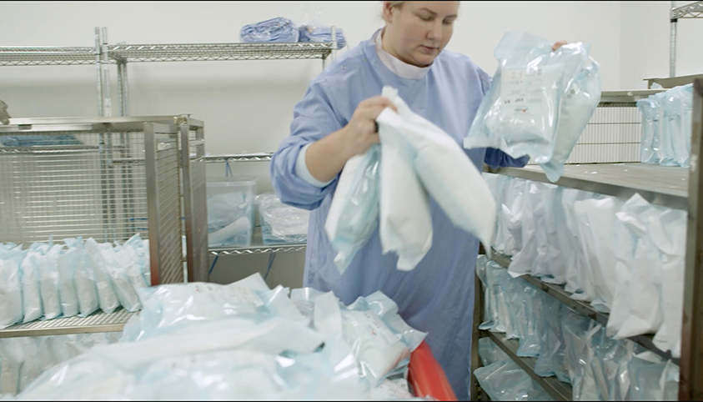
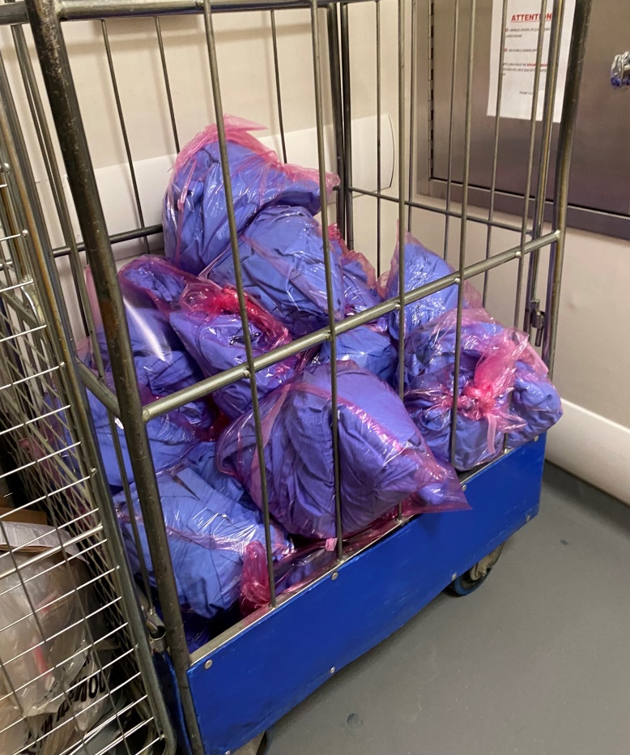
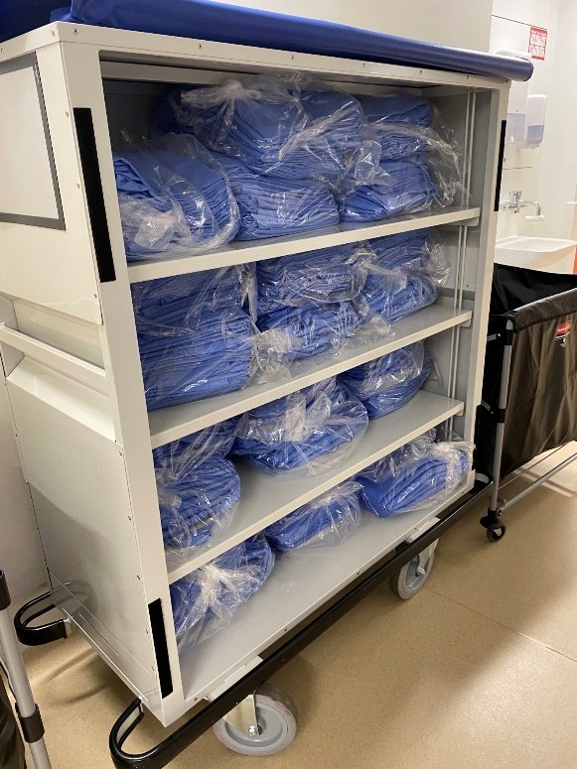
HOW-TO GUIDE
REUSABLE STERILE
& ISOLATION GOWNS
Notes:
ELIS COMMENT -
This information is required to ensure the process of manufacturing the sterile surgical gown is comprehensive. It is not just a case of purchasing a gown fabric compliant to the performance requirement in its initial state, the management system and process validation is required to ensure the reusable gown meets the essential requirements throughout its life and following numerous decontamination and sterilisation processes:
• There are several criteria required to place a sterile gown on the market in accordance with the Medical Devices Directive 93/42/EEC. It is a legal requirement for the manufacturer or processor to be registered with the Medicines and Healthcare products Regulatory Authority (MHRA). Elis is certified through Approved Body SGS (0120) who are accredited by the MHRA as the UK Competent Authority for medical devices.
• Fabric manufacture and performance is covered under the European Norm BS EN 13795-1:2019 – Requirements and Test Methods Part 1 Surgical Drapes and Gowns. This standard is required whether for reusable or disposable drapes and gowns, products must meet all the requirements specified in the standard throughout their whole life. BS EN 13795 specifies test methods for evaluating the identified characteristics of surgical drapes and gowns and sets performance requirements for these medical devices. The base materials used within Elis surgical gowns include a combination of densely woven microfilament polyester and 3-ply laminates dependent upon the level of performance required as specified in BS EN 13795.
• In order to achieve the performance requirements for whole life with reusable textiles, a Quality Management System is required. The standard specific to Medical Devices is ISO 13485:2016 Medical Devices - Quality Management Systems - Requirements for Regulatory Purposes. This is an ISO Standard (International Organisation for Standardisation) so can be used globally. It represents the exact requirements for a comprehensive quality management system for the design and safe manufacture of medical devices. Elis is certified though SGS; as we provide the Medical Device i.e. sterile gown pack, Elis is the legal manufacturer irrespective of who supplied the original gown. ISO 13485 is the foundation for proving compliance with the MDD UK and ensuring consistent procedures and processes.
• Any surgical gown processor should adopt a risk assessment and biocontamination control approach. BS EN 14065:2016 describes a management system for assuring the microbiological quality of processed textiles used in specifically defined sectors such as surgical textiles, in which it is necessary to control microbiological contamination. The minimum laundering requirements are in compliance with HTM 01-04 Decontamination of linen for health and social care. Elis are audited against BS EN 14065:2016.
• Reusable surgical gowns are steam sterilised in accordance with Health Technical Memorandum 01-01 – Decontamination of reusable medical devices, which covers the various types of decontamination equipment to be used for the reprocessing of medical devices.
January 11, 2024 at 1:50 PM

Slide 2


The Business Case
Sterile surgical gowns provide essential barrier protection between patients and staff during invasive procedures. Reusable surgical gowns have been shown to be superior for safety with no increased risk of infection, they can be laundered for reuse some 75 times or more and save around 45%* on cost and 69% on carbon compared to single use gowns
Why Reuse
Reusable gowns currently make up around 30% of the surgical gowns and 8% of the isolation gowns used by the NHS each year*, indicating significant scope to switch to reusable to save money and carbon.
Reusable gowns have the potential to save the NHS 5.2 kilo Tonnes CO2e**, 1.1 kilotonnes of waste**, 31m litres of water, and £9.4m* in costs across both surgical and isolation gowns.
Reuse Roadmap
Revenue and savings
On average reusable surgical gowns are 45%* cheaper, with VAT reclaimable on reusable products (NHS service code).
Liability and risk
Surgical gowns are medical devices that must meet BS EN 13795. Studies indicate reusable gowns outperform single use on key safety measures of protection, durability, fluid resistance and strength AJIC, with no measurable increased risk of infection IC&HE.
Case study example
Royal Derby Hospital moved to reusable sterile gowns reducing the number of single use gowns purchased annually from 100K to some 3k reusable gowns servicing the same 100k use requirements, delivering £91k financial savings, 19 Tonnes CO₂e and storage efficiencies.
Reuse Portfolio
Case Studies
Greener NHS ambition
Life Cycle Assessments (Blazewski & Rothman; Vozzola et al) report carbon reductions of 69% by switching, which also supports NHS aims to reduce single-use clinical plastics by 10%.
Additional Guidance
Ease of implementation
Laundered gowns are frequently replenished, requiring less storage space than single use gowns that are stored in greater volumes to ensure resilience for stock availability.
*NHSE calculations based on NHS and supplier data
** NHSE calculations based on Rizan et al. Life Cycle Assessment
Notes:
Reusable isolation gowns are available through DHSC and with compatible laundry services available through NHS Supply or Crown Commercial Services?
Gowns account for ~£10m out of £71m spent on PPE by providers, and
industrial laundering did not have a detrimental effect on the reusable gowns for any measured performance parameter.

Slide 3
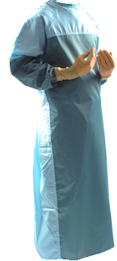
How to set up a reusable gown scheme
Reusable gowns deliver benefits for sterile surgical gowns (used in surgical theatres or other invasive procedures that use some aseptic techniques) and isolation gowns (used to provide non-sterile barrier protection to staff or patients on isolation wards³ or where extensive splashing of fluid is anticipated⁴). The savings potential can be maximised by referring to the National Infection and Prevention Control Manual (IPC) and applying the key principle of avoiding overuse or inappropriate use.
Why Reuse
Additional Guidance ​
​
Case Studies, a basic SOP for circularity, and protection standards are provided in the Additional Guidance section to assist implementation. ​
​
If you need more support, please contact the NHSE Net Zero and Sustainable Procurement team england.ccf-sustainability@nhs.net
​
Reuse Roadmap
Consult and investigate
Develop procedures and training
Communicate to end users
Introduce and Manage laundry service
Source gowns and laundry service
Sterile Surgical Gowns
Non-Sterile Isolation Gowns
Reuse Portfolio
Case Studies
Consult key stakeholders and identify end user concerns. Identify single use gown numbers and frequencies of use across different sites. Calculate carbon and financial benefits of switching. | Laundry frameworks include lots to procure reusable surgical gown services (LPP Linen & Laundry DPS, NoECPC 0572) and isolation gown services (NoECPC 0572). Include clinical leads in evaluation of gowns. | Develop a Standard Operating Procedure (SOP) specific to each gown type (surgical or isolation) covering gown donning and doffing, bagging and used gown collection. | Provide simple and clear messaging to end users addressing key concerns on protection levels and comfort; benefits of switching; and bagging processes. Train housekeeping/ cleaners on collection of used gowns. | Agree delivery frequency and monitor performance. Track and manage loss reduction through RFID asset tagging of gowns, site audits or improving user awareness through local campaigns.
Additional Guidance

Slide 4
Key Stakeholders
Bring key stakeholders on board early to understand the benefits of reusable gowns and to act as champions to encourage colleagues to support and feel comfortable with switching. These stakeholders are applicable to introducing either type of gown, and introduction of either gown type should be managed as separate projects.
Why Reuse
Reuse Roadmap
Estates and Facilities Managers | IPC and theatre leads | Sustainability & Procurement managers | End Users
Project manage the change and establish the SOP for gown provision, donning, doffing, bagging and laundry and train staff on following guidance. Responsible for correct storage and transportation processes and communicating with cleaning teams and porters. | IPC - responsible for providing information and advice on reusable gown selection, standards and product performance. Theatre Matrons and Managers can support clinical staff to adopt sterile surgical reusables, and ward Matrons can support the adoption of isolation gowns helping them to understand levels of protection and benefits, test gowns and provide feedback on product selection. | Help with business case, sourcing suppliers, determining service level agreements and monitoring progress. Support project lead to liaise with other stakeholders such as Dress Code Committees and budget holders (can be centrally funded or at the clinical level). | By following guidance on handling, bagging and laundry processes, end users can help avoid losses and increase the benefits of reuse. Clinical leads e.g. Director of Nursing and Consultants can act as champions to get all staff onboard.
Reuse Portfolio
Case Studies
Additional Guidance
Notes:
Green Theatre Checklist – preparing for surgery switch to reusable textiles Green Theatre Checklist | RCSEd
Notes
Stockport survey – other results Ease of opening the packaging and putting on the gowns, as well as the sizing of them, also ranked high.
Royal Liverpool case study - Misconceptions were found to be more prevalent in longer-serving staff members, although it seemed to be a commonly held view amongst all end users that multi-use surgical gowns were heavy, cumbersome and uncomfortable. today’s engineered fabrics are significantly more lightweight, breathable and wearable than previous alternatives. ne of our consultants even offered to have himself covered in water while wearing one of the garments to test its properties in terms of fluid repellence, and discovered it performed extremely well. In addition, as the disposable products were lower density than the multi-use products, additional layers may have been required for longer and more complex procedures, meaning more time spent preparing the patient for surgery and greater overall cost.

Slide 5
Additional Guidance
Case studies
Infection Prevention Control
  Basic Standard Operating Procedure
  Protection standards and evidence

Slide 6
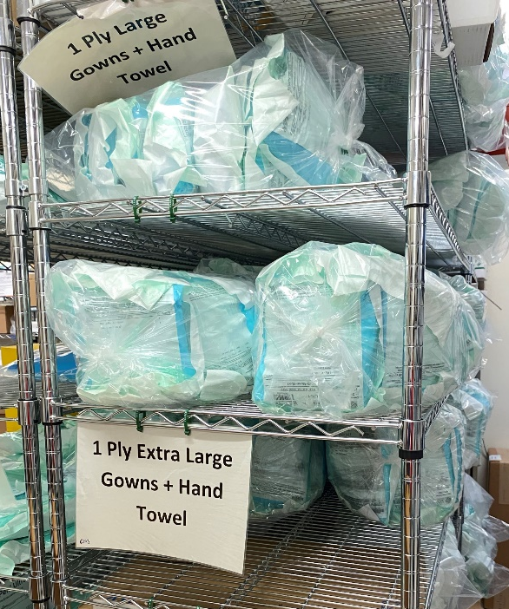

Derby and Burton long-term use of reusable surgical gowns
UHDBFT has been undertaking widespread use of reusable gowns across its busy Derby Hospital site for both sterile surgical gowns and isolation PPE gowns for over 10 years, with the potential to save 88 Tonnes CO2e and £91k in costs annually.
Why Reuse
Organisation
University Hospitals of Derby and Burton NHS Foundation Trust
Issue
Royal Derby Hospital, one of the largest elective trusts uses reuseable gowns across 50 elective theatres: with over 100k uses of reusable surgical gowns and 4k uses of reusable isolation gowns annually.
Reuse Roadmap
Action
Contracting a managed service for UK manufactured reusable gowns and other reusable textiles (drapes and patient gowns).
The supplier actively engaged clinicians on introduction to support the switch, provide confidence, reinforcing the bagging policy to ensure gowns can be washed up to 80 times before disposal.
Each theatre has a daily usage stock level sheet for accurate reordering of gowns.
Reuse Portfolio
Impact
The use of reusable gowns is saving annually 88 Tonnes CO₂e, 19 Tonnes of clinical waste, 520k litres of water, and £91k in procurement and clinical waste costs.
Orders of single use gowns have been reduced to 7% for surgical gowns and 1% for isolation gowns.
Stock losses are manged via staff education, onsite stock control and financial incentives, with outpatient clinics the focus area for improvement.
Case Studies
Additional Guidance
Lessons learned
The supplier played an important role in implementing the change through monthly calls and integration of representatives within the hospital.
Stock losses were found to generally result from incorrect disposal, with education of clinical staff needed to highlight that industrial cleaning and sterilisation can meet required standards for even heavily soiled gowns.
Notes:
Synergy data
2019 - Sterile Gowns Delivered:- 128253 and 0 PPE Gowns
2020 - Sterile Gowns Delivered - 94379 and 73983 PPE Gowns
2021 - Sterile Gowns Delivered - 92680 and 68960 PPE Gowns
2022 - Sterile Gowns Delivered - 102660 and 2880 PPE Gowns

Slide 7
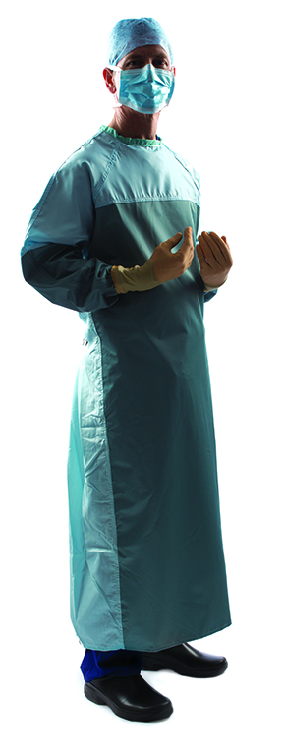

Stockport NHS Foundation Trust
Seeking to improve cost efficiency, reduce carbon and the volume of clinical waste, Stockport Foundation Trust introduced sterile surgical reusable gowns at its main site Stepping Hill Hospital in 2019 and continues to use them.
Why Reuse
Organisation
Stockport NHS Foundation Trust
Issue
The trust’s main site Stepping Hill Hospital treats over 500k patients per year, including one of the largest orthopaedic services in the UK, generating significant volumes of clinical waste annually (approx. 700 Tonnes), largely from its theatres.
'Our staff and consultants have responded positively to the switch, and we have benefited from cost savings'
Bob Unwin
SNHSFT Directorate Manager
Reuse Roadmap
Action
Sterile reusable gowns were trialled in multiple theatres, ophthalmology and maternity wards, to gather staff feedback in preparation for roll out.
A show and tell day for staff helped to educate them about gown protection and use prior to rollout across all departments, including some of Orthopaedics.
Reuse Portfolio
Impact
Staff responded positively, with trial feedback that 94% found the gowns to be clinically acceptable, and 96% stating they provided excellent or satisfactory protection levels. Ease of donning gowns, and sizing also ranked high.
The switch from 45k single use gowns, to 45k uses of reusable gowns saved 5.2 tonnes of clinical waste, 14.4 tonnes of CO₂ and £18.7k per annum, including VAT reclaim on the reusable gowns and clinical waste costs.
Rated for 75 x decontamination and sterilisation, RFID asset tagging to trace the number of washes, 2 days stock onsite and daily deliveries providing resilience.
Case Studies
Lessons learned
The switch helped the trust through supply challenges during COVID, providing more resilience of supply and avoiding the costs increase of single use items.
Pre rollout staff education helped them to understand the significant changes in technology, with today's gowns certified as medical devices.
Ongoing education on following sterile laundry SOPs to reduce stock losses and improve carbon savings by reducing the incorrect disposal of soiled items as clinical waste is needed.
Additional Guidance

Slide 8


Royal Papworth reusable isolation gowns
In 2021 Royal Papworth designed and purchased reusable PPE gowns for isolation wards from a local supplier, saving £108k through a separate service contract, 126 tonnes CO₂e and improved supply resilience during COVID-19 stock shortages.
Why Reuse
Organisation
Royal Papworth Hospital NHS Foundation Trust
Issue
Leading heart and lung hospital treating around 50,000 patients per year, operating 6 theatres and 300 beds, using on average 2,200 gowns per week in ICU.
Reusable isolation gowns were sourced due to COVID-19 related supply shortages.
Staff had experienced issues with previous disposable gowns with small sizing, discomfort around the neck and sleeve area and tears.
Reuse Roadmap
Action
Reusable splashproof non-sterile gowns were purchased for theatre staff (not including surgeons), switching to large and x-large gowns to improve staff comfort, with a product life of 2 years.
Initial concerns of staff around stock availability and protection levels, were quickly addressed through product trials and information sessions.
Staff were trained on donning, doffing and collection procedures at implementation.
Repairs and additional splash proofing treatment was included in the gown cleaning service provision to extend the life of the gowns.
Reuse Portfolio
Case Studies
Impact
The switch saved 126 tonnes CO2e, 27 tonnes of waste, and £108k over 2 years
Staff found the new gowns to be better on breathability, comfort and coverage.
Staff experiencing protection levels via mock splash tests and trying on gowns enhanced their feeling of safety and confidence in the protection levels.
Additional Guidance
Lessons learned
Supplier aftercare service levels for repairs, cleaning, stock management and material comfort/softness improving with time increased confidence in the gowns and service.
Re-treatment of the gowns can be used to extend the life of the gowns.
Including the used gown collection process in the cleaning contract (under PFI site management), would avoid the need for additional nursing staff time to support logistics.
Consider extra time needed for gown collection when scoping out resourcing and contract requirements
Notes:
They use 2,000 gowns per week across 6 theatres, 97,600 gowns p.a., generating 14 Tonnes waste and 88 tCO2e carbon per annum (is this old?)
61 t CO2e carbon saved equivalent to emissions sequestered annually by forest size of 234 football pitches
12.6 t of waste

Slide 9
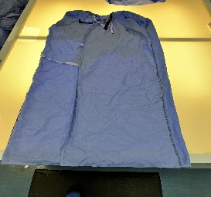


Basic Standard Operating Procedure (SOP) for circularity
A SOP covering the transfer of gowns from use to collection for laundering can reduce gown damage and loss, significantly improving the financial and carbon benefits. Research identifies gowns only need to be reused 4-12 times to be better than single use for most impacts reviewed under a Life Cycle Analysis⁴. Refer to IPC guidance^{5, 6} to support SOP development.
Used gowns sent for laundry.
Infectious gowns double bagged in dissolvable bag inside impermeable bag and placed in collection bins (HTM:01-04)
Gowns returned to NHS
Laundry sent for cleaning and repairs
Gowns provided in storerooms and robing rooms
Gowns donned and used by clinical staff
Why Reuse
Gowns washed,
repaired,
sterilised and
inspected
Managing bagging errors
Work with suppliers to manage returns of incorrectly bagged items where laundry services are split across different suppliers.
Reuse Roadmap
Reuse Portfolio
Minimising stock losses
Educate end users on the importance of following bagging procedure to reduce gown losses e.g. incorrectly placed in linen laundry or clinical waste.
RFID asset tagging of gowns can help identify problem areas to address.
Case Studies
Minimising damage
Clear procedures, training and awareness to avoid damage:
No personalising or altering
Correct donning and doffing
Additional Guidance

Slide 10
Protection from reusable gowns
Reusable gowns meet the same Standards & Guidance for protection as single use, with additional standards for sterile services*. Evidence shows they outperform in key test areas and combined with Awareness raising at trust level can support clinical confidence in their use.
Why Reuse
Standards & Guidance
BS EN 13795 *Surgical clothing and drapes – Requirements and test methods – for manufacturers, processors and products, test methods, performance requirements and performance levels
HTM 01-01 *Decontamination of medical devices - explains the management of decontamination and the various ways to sterilize reusable medical devices used in acute care
HTM-01-04 **Decontamination of linen for health and social care – provides guidance for those who process linen such as laundries, launderette operators and linen processors (Guidance for implementing BS EN 14065)
ISO 13485 *Medical Devices – Quality Management System covering the product lifecycle from design, manufacture to installation and services.
Reuse Roadmap
Reuse Portfolio
Evidence
Reusable gowns out-performed disposable gowns in all tests at all wash levels for ability to provide adequate protection across their expected service lifespan
Level I, II, and III gowns were tested for water resistance, hydrostatic pressure, and durability (breaking, tear, and seam strength, pilling resistance, dimensional stability, and air permeability)
Data was collected for new disposable gowns and after 1, 25, 50, and 75 washes for reusable gowns.
McQuery et al, Performance Comparison.
Case Studies
Awareness
Address common misconceptions and improve awareness, through actions such as:
staff gown trials
show and tell days
mock fluid repellence tests using water
Post trial survey results
94% of staff found reusable gowns clinically acceptable, and 96% stated that they provided excellent or satisfactory protection levels.
Stockport NHS Foundation trust
Additional Guidance
*Applies to sterile surgical gowns only **Applies to both non-sterile and sterile gowns
Notes:
US FGDA going to use ISO 13485 as basis for quality system legislation

