Slide 1
Public Health, Sustainability and Occupational Therapy
Linda Hindle, Allied Health Professions Lead, Public Health England
@hindlelinda
Notes:
Talk about my role

Slide 2
Format
What is good for health is good for sustainability
Why we need to take action now
Our ambition for AHPs and public health
What needs to happen
Current contribution of AHPs to public health
What more can you do?
sustainability

Slide 3
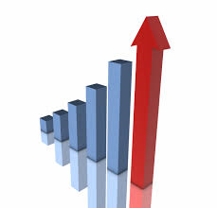


Health is a vital resource for our country
Being productive
81% of Britons believe that Government should prioritise creating the greatest happiness, not the greatest wealth
Healthy People
A virtuous circle
Building a strong society
Notes:
Opinion bubble reference – NEF 2013

Slide 4
The costs of neglecting health across the life course are huge, for government and society
Starting with school
There is an association between lack of physical activity and poor school performance
Affecting productivity
One in seven men develops clinical depression within 6 months of losing their job. Once depression has developed, finding a job is even harder
£14b per year lost through sick days – the main reasons are musculo-skeletal and emotional wellbeing
Leading to job prospects
Health and social care costs
Public expenditure on social care for older people to rise to £12.7b by 2022 (an increase of 37% from £9.3b in 2010) to keep pace with
expected demographic pressures
Notes:
1. Ref: Associations between objectively measured physical activity and academic attainment in adolescents from a UK cohort.
Booth, J. N., Leary, S. D., Joinson, C., Ness, A. R., Tomporowski, P. D., Boyle, J. M. & Reilly, J. J. 2013 In : British Journal of Sports Medicine.
2. http://www.cbi.org.uk/media/2150120/cbi-pfizer_absence___workplace_health_2013.pdf
3. http://www.kingsfund.org.uk/audio-video/improving-publics-health-infographics
4. http://www.nuffieldtrust.org.uk/sites/files/nuffield/publication/121203_care_for_older_people_1.pdf

Slide 5
Health and sustainability: a common agenda
sustainability
Notes:
The Barton and Grant conceptual model highlights the importance of the wider determinants on health
Source: Barton H, Grant M (2006). A health map for the local human habitat. Journal for the Royal Society for the Promotion of Health, 126 (6). 252-253

Slide 6
A sustainable development strategy for the NHS, Public Health and Social Care
Goal 1 Creating a Healthier Environment
Goal 2 Communities and Services are ready and resilient for changing times and climates
Goal 3 Every opportunity contributes to healthy lives, healthy communities and healthy environments
sustainability

Slide 7
We know what the fundamental causes of ill-health are…
Health and wellbeing are the work of a lifetime
They do not happen by chance
Health must be promoted all through life
The building blocks of good health
Good education
Safe Environment
Sense of purpose
Individual behaviours
Strong community
Decent housing
Meaningful work
Adequate income

Slide 8
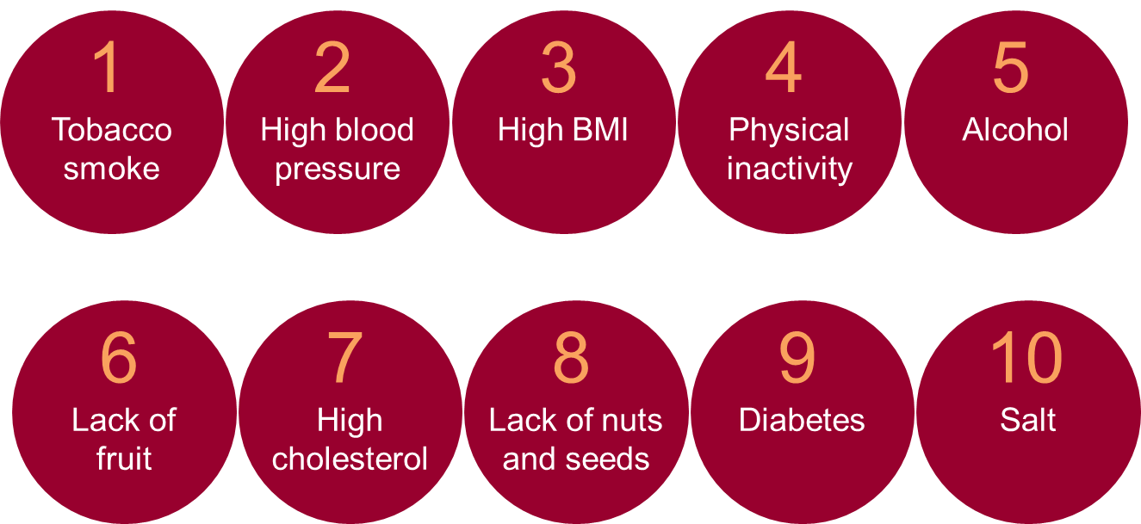
…and they align with the immediate causes of ill health…
Overweight & obesity
Top 10 contributors to years of life lived with disability
Notes:
Source – Global Burden of disease

Slide 9
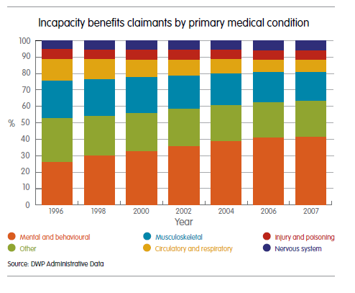
…which contribute to the main forms of disability…
The main forms of disability map exactly to incapacity benefits – mental illness and musculoskeletal come out on top
Musculoskeletal disorders
Mental illness
Diabetes
Chronic respiratory diseases
Neurological disorders
Unintentional injuries
Cardiovascular disorders
Cancer
Notes:
Source – Global Burden of disease, DWP administrative data

Slide 10
…and the major killers.
Top causes of under 75 mortality – 2010
Raised blood pressure accounts for 50% of all heart disease
Around 86% of lung cancer deaths in the UK are caused by tobacco smoking
Notes:
Chart from GBD data 2010 for UK after cause of death processing, PHE / GBD team analysis
Blood pressure figure - World Health Report 2002. Reducing risks, promoting healthy life. World Health Organisation, 2002.
Lung cancer figure – Cancer Research UK

Slide 11
Pressures on health spending are set to increase… challenging the NHS
Total expected NHS position against mandate (2013/14 - 2020/21)
c£30bn funding gap
To bridge this gap productivity improvements would need to be c.3.5% annually between 13/14 and 20/21
Source: NHS England (2013)

Slide 12
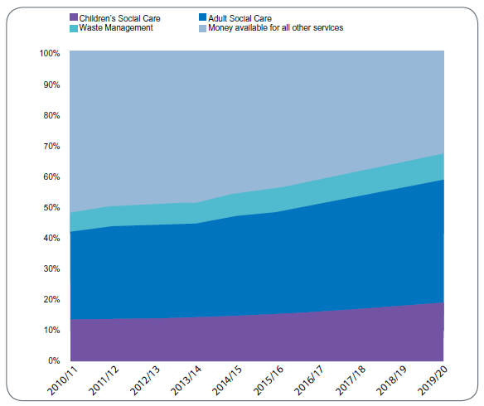
Local Authorities may struggle to provide basic services
Within 10 years, adult social care and children’s services will account for 50% of council budgets
Other services e.g. transport, fire safety will be squeezed
Source: LGA – Funding outlook for councils from 2010-11 to 2019-20

Slide 13
But we can change this if we work collectively
Contributors to health outcomes
Health
Behaviours 30%
Socioeconomic Factors 40%
Clinical Care 20%
Built Environment 10%
Education 10%
Smoking 10%
Access to care 10%
5%
Environmental Quality
Employment 10%
Diet/Exercise 10%
Quality of care 10%
Income 10%
Built Environment 5%
Alcohol use 5%
Family/Social Support 5%
Poor sexual health 5%
Community Safety 5%
We have to concentrate action on all fronts
Notes:
Source: Robert Wood Johnson Foundation and University of Wisconsin Population Health Institute

Slide 14
We know there are interventions which improve health, are sustainable, and reduce costs
Sustainability
Health
Cost Reduction
The sweet spot for public policy interventions
We also know of interventions which deliver return on investment within 5 years – what’s stopping us from implementing them?

Slide 15
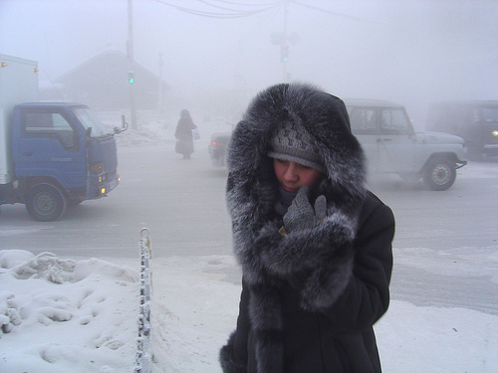
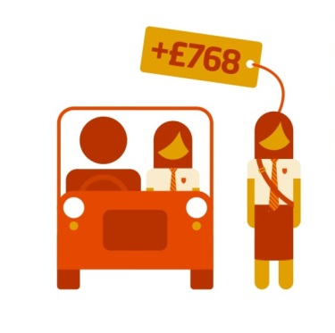
For example… effective interventions
Yakutsk, Russia is the coldest permanently inhabited town in the world. Winter temperatures regularly reach -45°C.
They have no excess winter deaths.
So why we have did 31,100 excess winter deaths in the UK in 2012/13? ⁽¹⁾
An Investment of £251m to reduce domestic impacts of excess cold could deliver savings of £859m within year in terms of reduced health costs ⁽²⁾
Better insulation saves costs (for the taxpayer and consumer), improves health, and increases sustainability. It also delivers immediately.
Getting just one more child to walk to school could pay back the equivalent of £768 in health benefits to individuals, savings in NHS costs, productivity gains and reduction in air pollution and congestion ⁽³⁾
Notes:
Yakutsk Russia data from - BMJ VOLUME 317 10 OCTOBER 1998, G C Donaldson, S P Ermakov, Y M Komarov, C P McDonald, W R Keatinge. Winter deaths data – ONS, November 2013
2) This assumes full coverage. Source: Good housing leads to good health: a toolkit for environmental health practitioners. London, Chartered Institute of Environmental Health, 2008. (http://www.cieh.org/uploadedFiles/Core/Policy/Housing/Good_Housing_Leads_to_Good_Health_2008.pdf
Accessed: 19/09/2013)
3) Kings Fund

Slide 16

Occupational Health
Sickness absence costs the UK around £15 billion annually in lost economic output
£13 billion is spent on health related state benefits
In the NHS almost 40% of staff sickness absence is due to musculoskeletal conditions
York Teaching Hospital NHS Foundation Trust were losing £3.7million/year in sickness absence in 2008
Investing £160k in a occupational health team inc physiotherapists resulted in annual savings of £1.2 million

Slide 17
Our Ambition – AHPs are recognised as an integral part of the public health workforce
Well over 170,000 AHPs in UK
Over 4 million contacts per week
AHPs work across NHS, social care, education, private and voluntary sectors
We work across the life course in a wide range of specialities
AHPs have the potential to add to virtually every public health priority

Slide 18
Why AHPs are well placed to be public health practitioners
We routinely incorporate questioning around healthy lifestyles and wellbeing within our assessments.
Many of us have skills in motivational interviewing and cognitive behavioural therapy.
Many of our interventions are geared towards encouraging patient’s to change.
We have a good understanding of the implications of poor health and lifestyle choices.

Slide 19
Why we need to act now
The scale of the challenge – sustainability of our health and social care system
We are reducing premature mortality but not as fast as many other high income countries
Rising prevalence of most chronic diseases
Inequalities remain wide: a 10 year difference in life expectancy between least and most deprived 10% of population.
Worrying trends (e.g.: cases of diabetes increasing, increase in childhood obesity)
Notes:
Scale of challenge including aging population, increased demands on healthcare and limited resources

Slide 20
So what needs to happen
Urgent need to shift focus towards prevention
We need to take every opportunity to create the environment, information and support to help people and communities change their behaviour and to enjoy better health and wellbeing.
Evidence based approached
Appreciation of health inequalities

Slide 21
Contribution of AHPs recognised by PHE
Notes:
Kevin’s statement
Creation of my role
The response of colleagues to my role

Slide 22
Are we working as public health practitioners already?
Notes:
Ask for a show of hands – who is already doing some form of public health work?
What form does this take?
Make the point that we are doing a lot already. Some of our core work is actually public health, we just don’t call it that

Slide 23
What do we mean by public health?
Improving the wider determinants of health
Health improvement – making every contact count
Health protection
Healthcare public health – preventing premature mortality

Slide 24
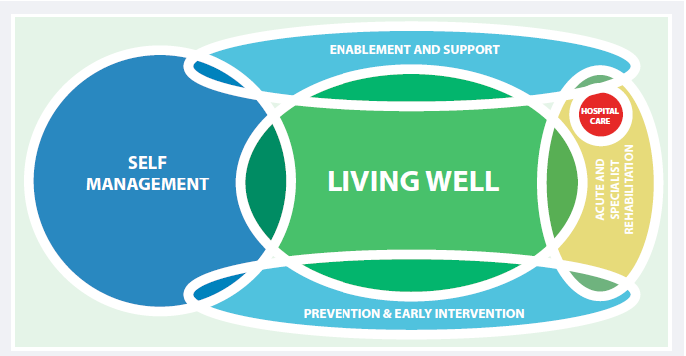
Sustainable healthcare

Slide 25
Are we working as public health practitioners already?
Notes:
Ask for a show of hands – who is already doing some form of public health work?
What form does this take?
Make the point that we are doing a lot already. Some of our core work is actually public health, we just don’t call it that

Slide 26
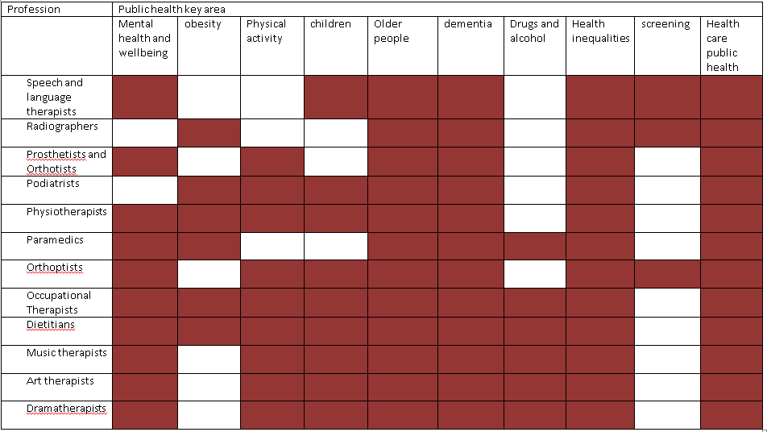
We are doing public health already

Slide 27
Could we do more?
Notes:
Get a view from the room on this including the barriers

Slide 28
It’s not always easy
Commissioners
Leadership and Service redesign
Training
Evidence

Slide 29
Opportunities for AHPs
We can use public health as a tool to raise our profile
We are doing public health already
We may appeal to a wider group of commissioners

Slide 30
My role
To achieve our collective ambition of AHPs being recognised as an integral part of the public health workforce

Slide 31
How Will We Know We’ve Got There?
AHPs are enthused about public health
All AHPs can describe the public health element of their role
Commissioners recognise the value and impact of AHPs on public health

Slide 32
Achieving the Ambition
Engage and attract AHPs to public health
Sell AHP contribution to commissioners
Increase public health component of training
Improve communication
Focus our collective efforts to make a visible impact

Slide 33
Agreed Priorities
Children ready for school / early years (language development, nutrition, physical skills, emotional development, vision)
Making every contact count (particular emphasis on obesity, physical activity, smoking and alcohol)
Improving health for older adults (nutrition, falls, maintaining independence, dementia, social isolation, mobility)
Emotional wellbeing (achieving parity of esteem of emotional wellbeing in line with physical health, holistic care)

Slide 34
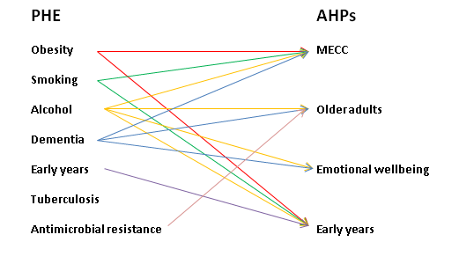
Alignment of AHP public health priorities to PHE’s 7 priorities

Slide 35
PHE AHP Project Boards
Clarity about current AHP contribution
Increasing strategic connections
What could we do more at scale
How we measure our impact
How we communicate our public health role within our professions
Communicating our role to wider stakeholders
Influencing research

Slide 36
So what needs to change
Allied health professionals need to talk about their public health role, evaluate it and think about how to do more
Service planners and commissioners need to consider how to get public health value from their AHP contracts
Public health commissioners could consider whether AHPs should be part of commissioning plans
Educators need to ask if their curriculum includes proper attention to public health and prepares the workforce for a wider role.
Researchers need to ask if they can publish more on the potential impact of AHPs on public health.

Slide 37
Contribution of Occupational Therapists
OTs already get this agenda
Profession | Public health key area
 | Mental health and wellbeing | obesity | Physical activity | children | Older people | dementia | Drugs and alcohol | Health inequalities | screening | Health care public health
Occupational Therapists

Slide 38
Where OTs can support the ambition
Promote what you do already
Can you do more
Evaluate and write up what you do
Support the 4 priorities
Develop conversations about public health with commissioners

Slide 39
PHE, NHSE and Sustainable development Unit resources and toolkits
Health and Wellbeing Toolkit
http://www.sduhealth.org.uk/areas-of-focus/community-resilience/health-and-wellbeing-board-toolkit.aspx
Strategy and modules, including sustainable healthcare
http://www.sduhealth.org.uk/policy-strategy/engagement-resources.aspx

Slide 40
Thank-you
Linda Hindle
linda.hindle@phe.gov.uk
@hindlelinda

