Slide 1
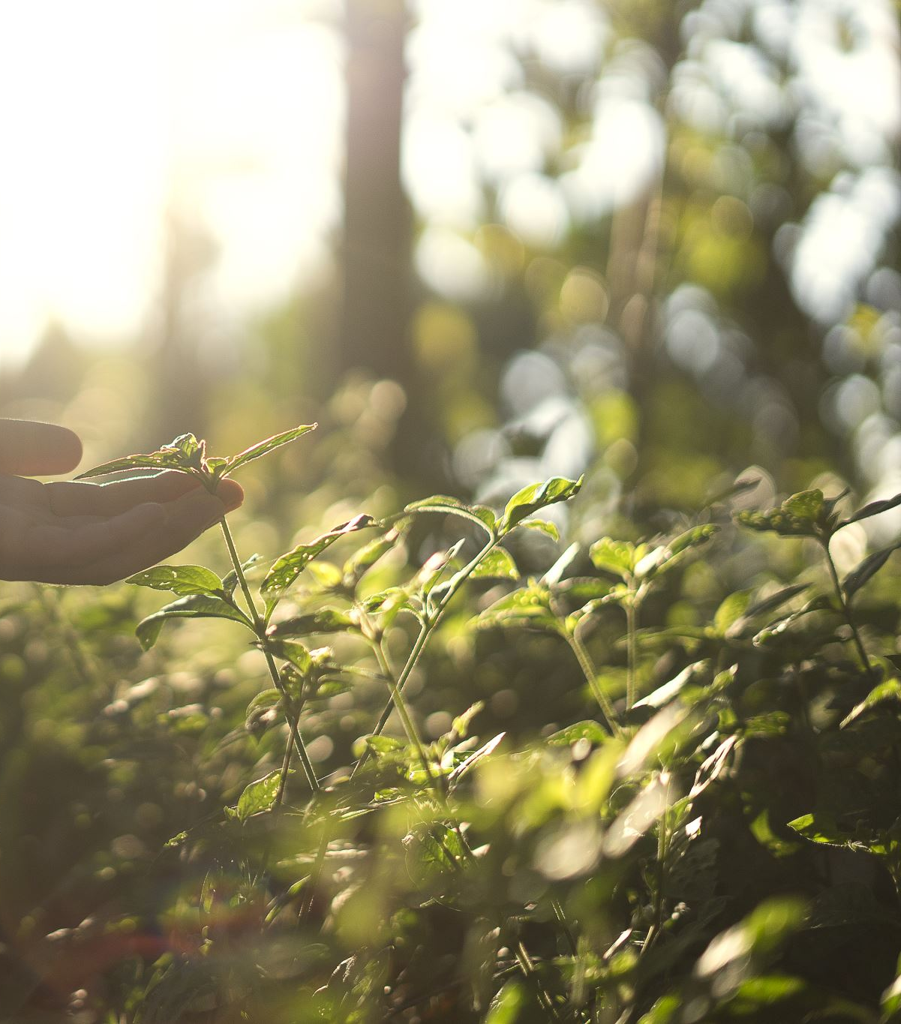
OTs using Nature-Based Interventions
An Exploratory Study
Marty Climenhaga, PhD (Eng); M.Sc. OT Student
James Gavin, PhD, FHEA; Lecturer in Musculoskeletal Health for OT

Slide 2
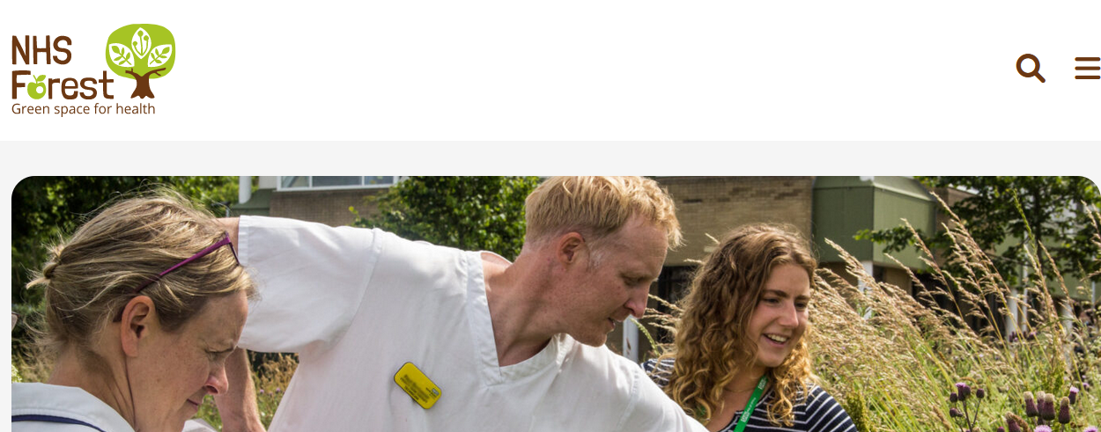
https://nhsforest.org.uk/
sustainablehealthcare.org.uk
Annual Online Conference: October
‘inspires and supports healthcare sites in transforming their green space for health, wellbeing and biodiversity’

Slide 3
Health Benefits of Nature Exposure - Outdoors
Physical
Mental
Social

Slide 4
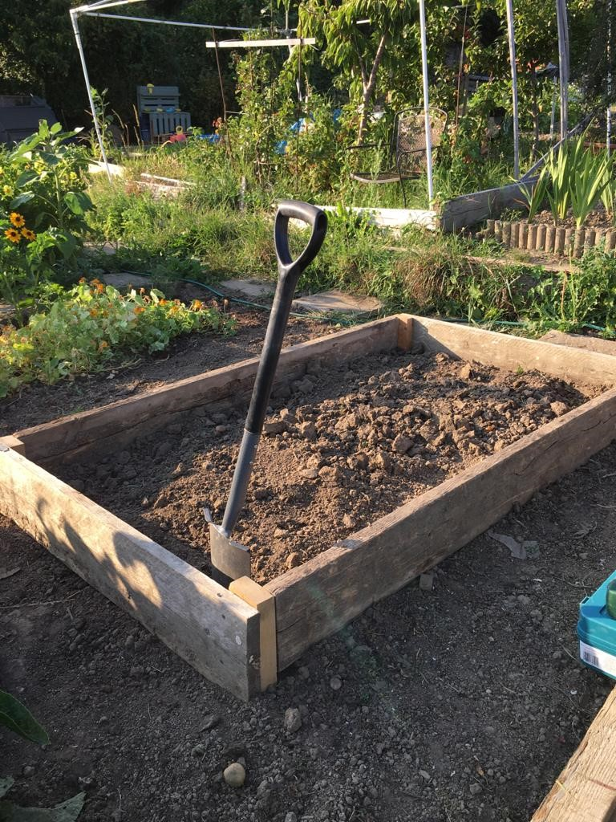
Physical Health
Encourages physical activity (Remme et al., 2021)
Improved sleep (Raine et al., 2017)
Can inspire healthier lifestyle choices (Raine et al., 2017)
‘Old friends’ beneficial microbial exposure (Flies et al., 2018)
Cardiovascular benefits: blood pressure, resting heart rate, BMI (Hanson and Jones, 2015)
Immune system benefits: lowered inflammatory biomarkers (Chae et al., 2021)

Slide 5
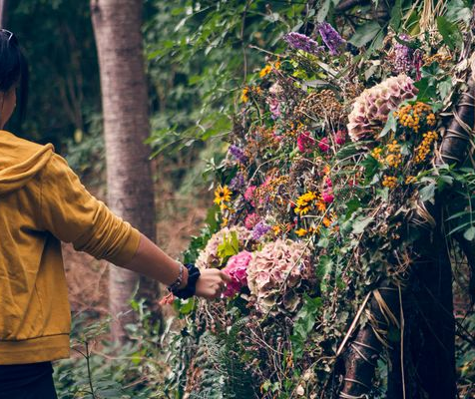
Mental Health
Reduces rumination (Bratman et al., 2015)
Improves self-esteem (Howarth et al., 2018)
Reduces anxiety (Coventry et al., 2021)
Improves positive affect (Iwata et al., 2016)
Reduces depressive symptoms (Swinson et al., 2020)
Facilitates social connection (Raine et al., 2017)

Slide 6
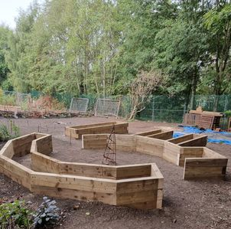
Social / Societal
Areas with more green space have less health inequality (Mitchell and Popham, 2008)
Being in nature promotes pro-social behaviours among adults and children (Park Figueroa, 2021)
Builds confidence, resilience in children
ADHD - kids with ‘behavioural’ issues in classroom do well in natural settings (Faber Taylor and Kuo, 2011)

Slide 7
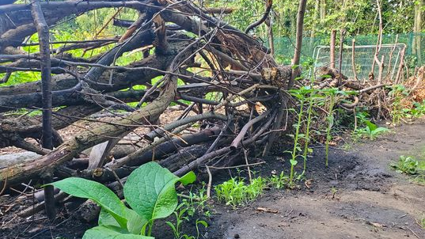
Outpatient Neuro
Rehab
M.Sc. Dissertation
Qualitative Study
Semi-structured interviews
6 participants
Community Mental Health
Mental
Health
Inpatient Rehab
Settings
Community NHS/HMPPS ex-prisoners
Forensic Mental Health
(low secure)
Forensic Mental Health (med secure)
Ekho Collective: https://www.facebook.com/Ekhocollective/

Slide 8
Park & seaside walking sessions
Outpatient Neuro
Rehab
Balcony Garden
Woodland Crafts
Community Mental Health
Mental
Health
Inpatient Rehab
Nature-Based Interventions
Services
Allotment Gardening
Nature Walks
Community NHS/HMPPS ex-prisoners
Forensic Mental Health
(low secure)
Green Gym Workshop
Butterfly Gardening
Forensic Mental Health (med secure)
Ekho Collective: https://www.facebook.com/Ekhocollective/

Slide 9
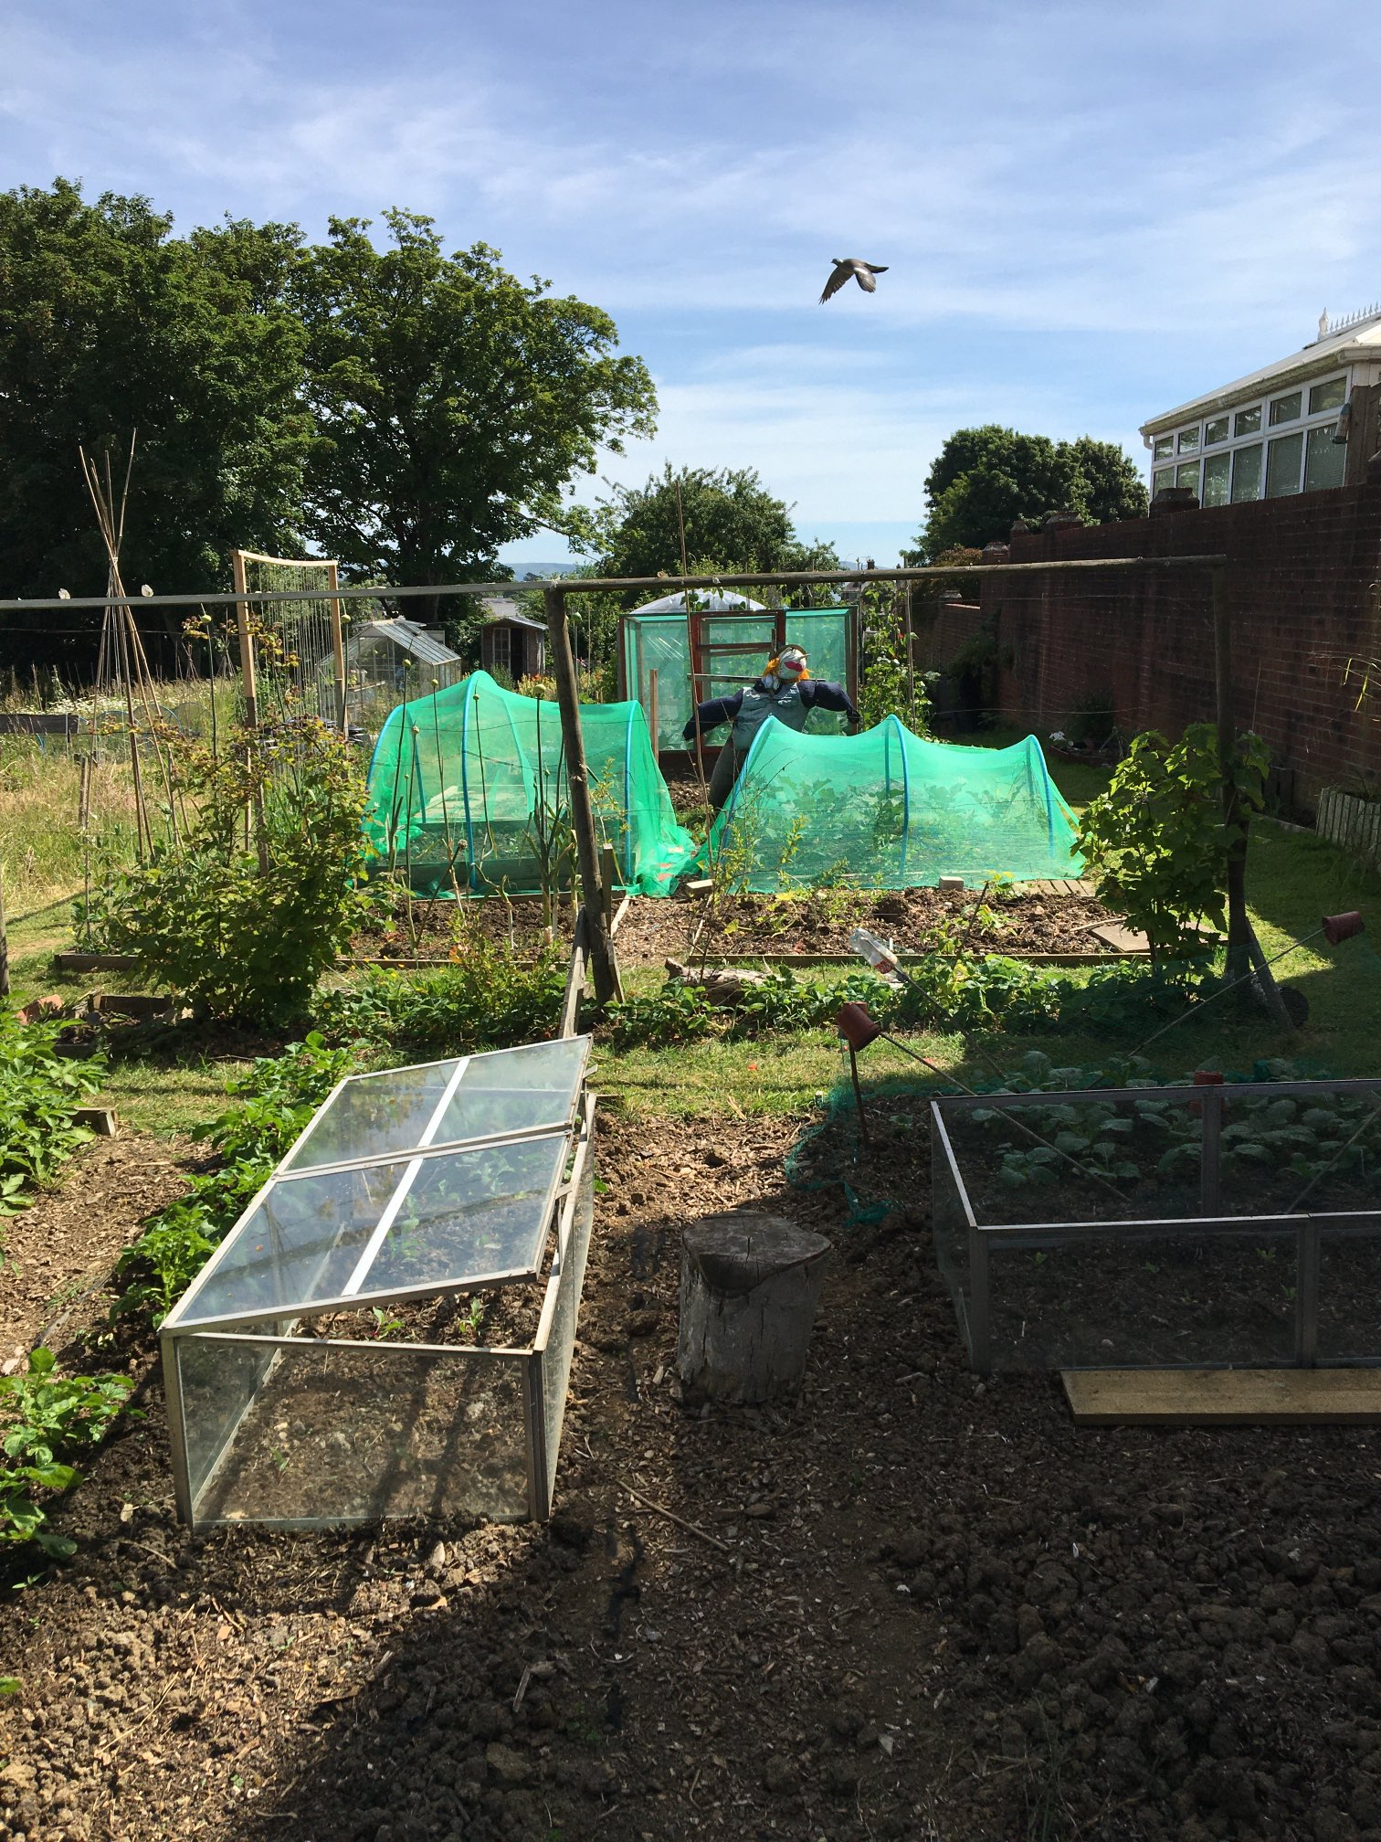
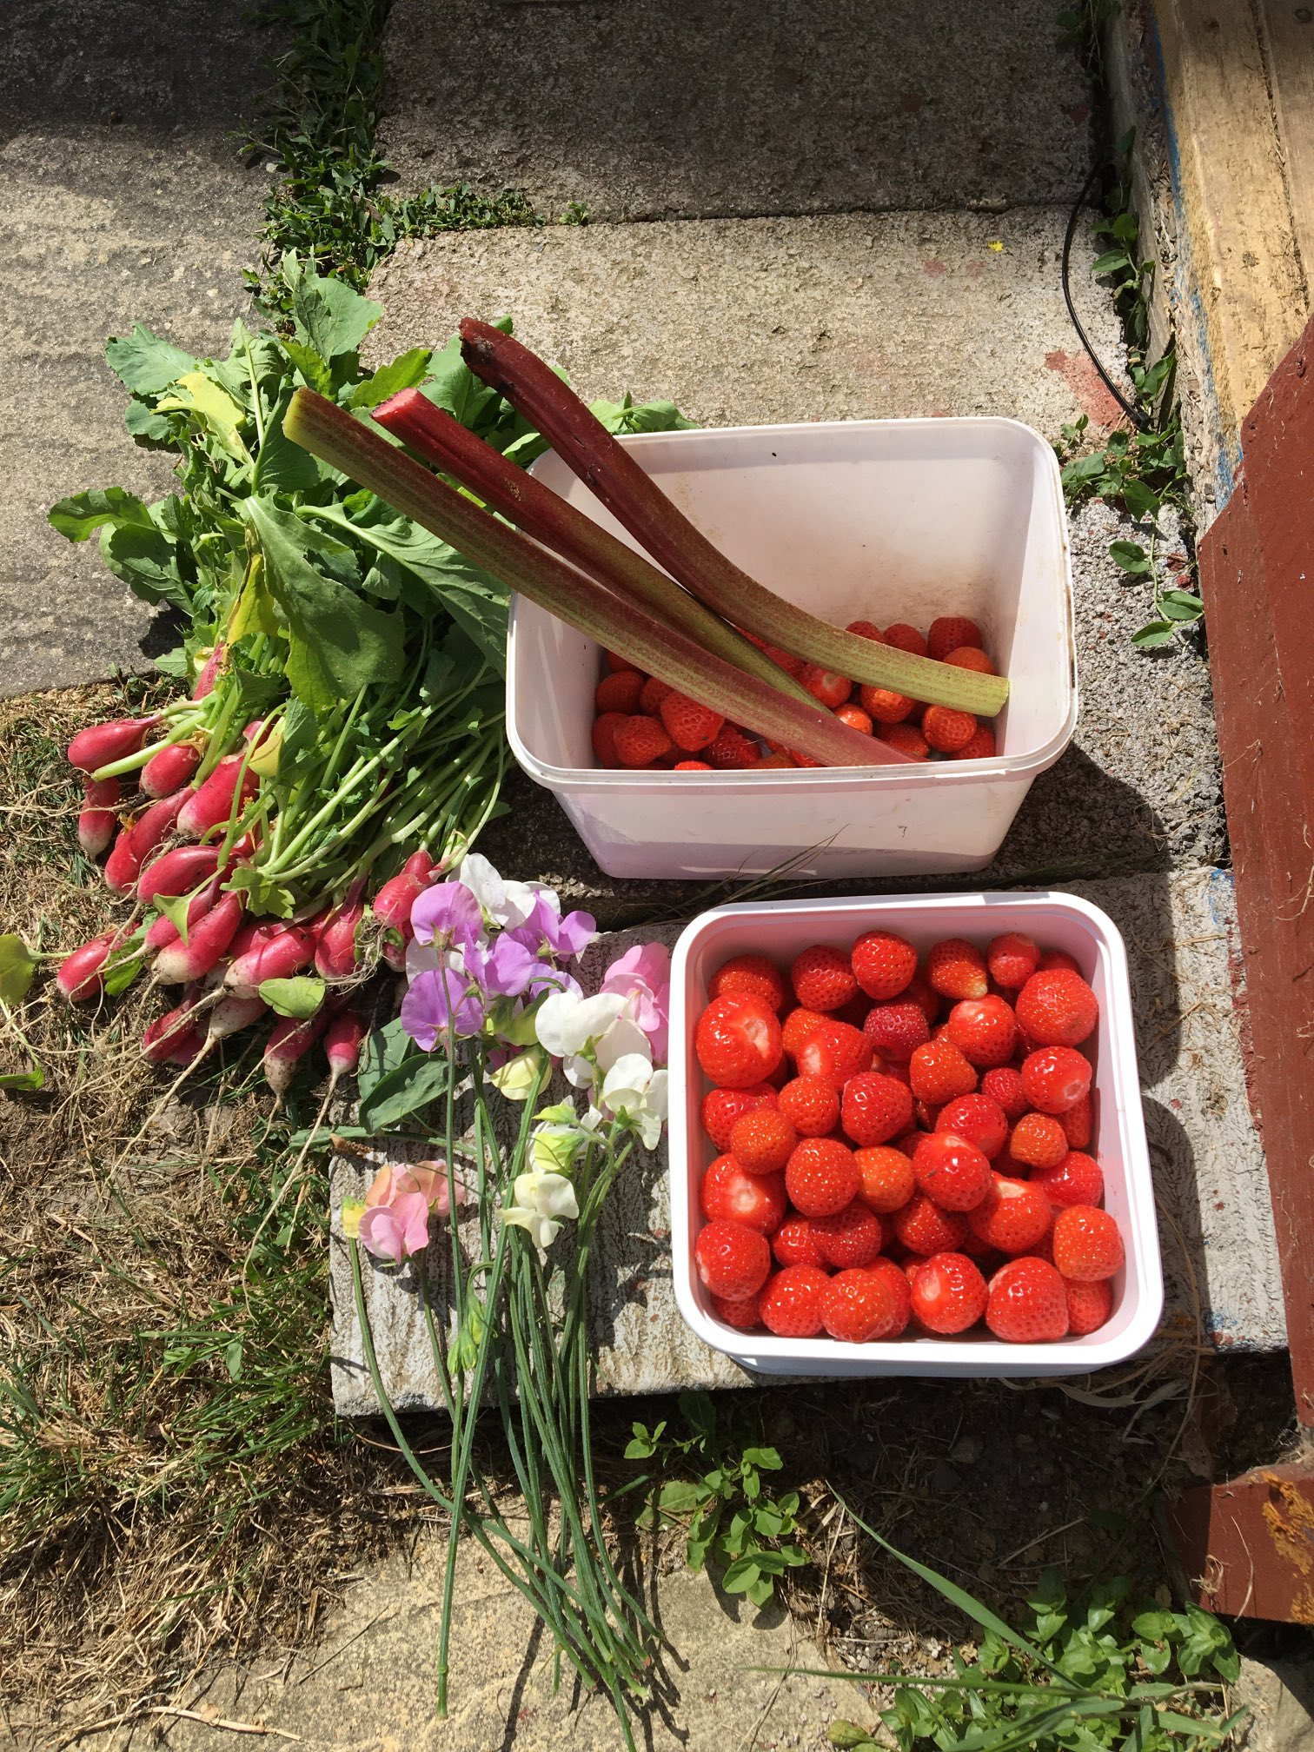
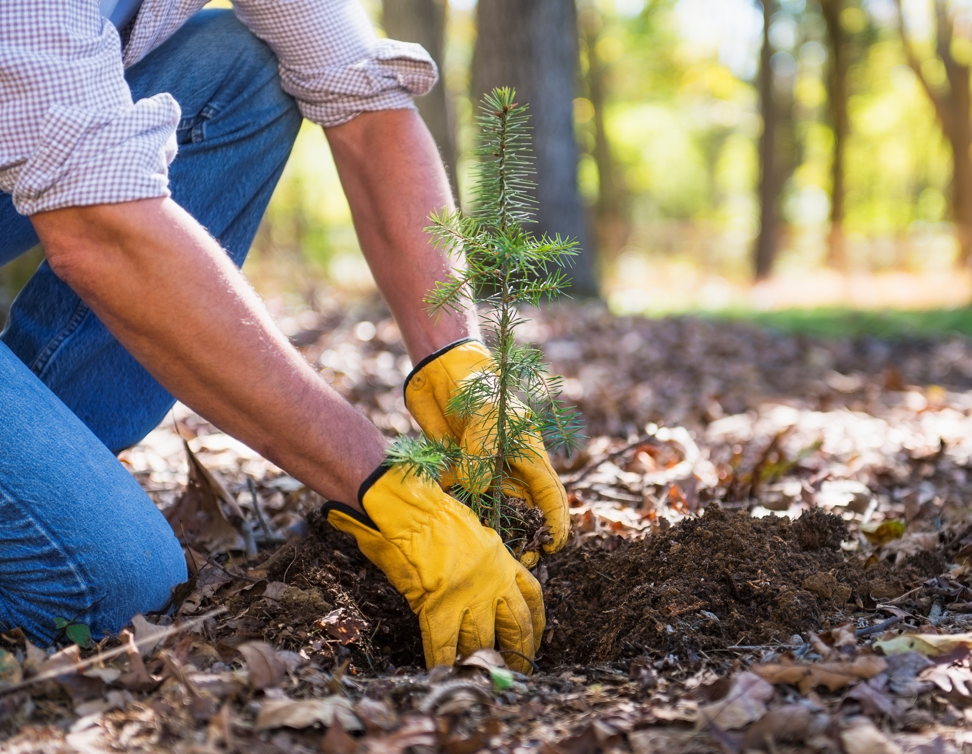
Relationships
Purpose
Themes
Identity
Developing Skills
Co-Production
Freedom
STRIVE/IIRMS, Dorset on Twitter: https://twitter.com/DorsetIirms/status/1537464294740312066

Slide 10
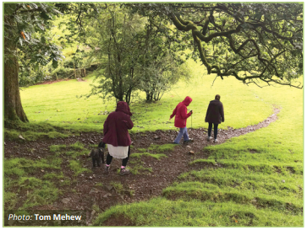
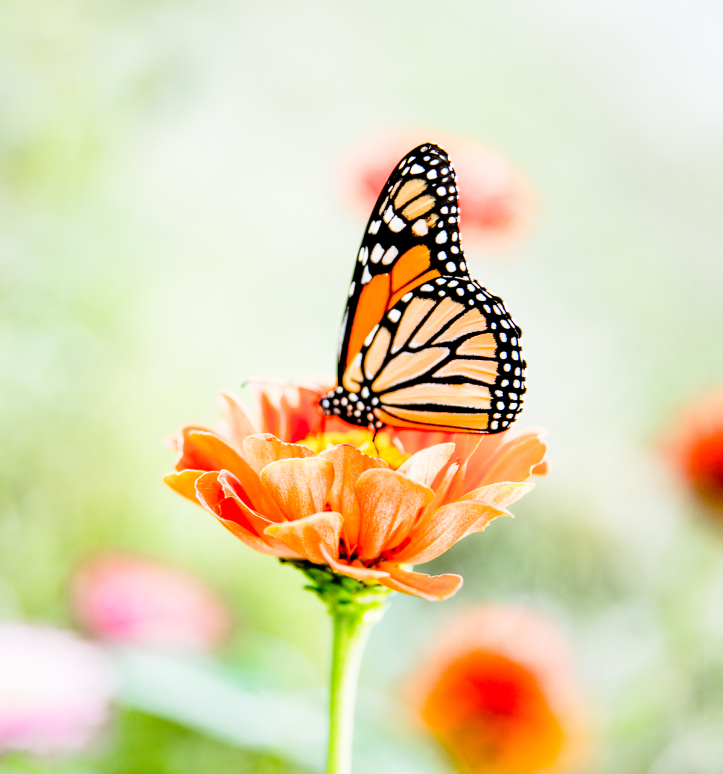
Recommendations
Plan thoroughly – but allow flexibility
Clear Rationale
Build Relationships
Identify Barriers before naysayers do
Find a simple outcome measure
Document in a user-friendly format

Slide 11
Thank You!
mac1d20@soton.ac.uk
mclimenhaga@hotmail.com
With Thanks to Ben Whittaker, Carey Newson & Miriam Dobson, Centre for Sustainable Healthcare
More Information at:
NHS Forest https://nhsforest.org/evidence/
Centre for Sustainable Healthcare sustainablehealthcare.org.uk
CSH Green Walking Guide https://sustainablehealthcare.org.uk/green-walking
Thrive – Gardening for Health https://www.thrive.org.uk/get-training/courses-and-workshops
MIND/University of Essex - https://www.mind.org.uk/media/4418/ecominds-effects-on-mental-wellbeing-evaluation-report.pdf
Dose of Nature https://www.doseofnature.org.uk/
Photo: Centre for Sustainable Healthcare

Slide 12
References
Bratman, G. N., Hamilton, J. P., Hahn, K. S., Daily, G. C., & Gross, J. J. (2015). ‘Nature experience reduces rumination and subgenual prefrontal cortex activation’. Proceedings of the National Academy of Sciences of the United States of America, 112(28), 8567–8572.
Chae, Y., Lee, S., Jo, Y., Kang, S., Park, S., Kang, H. (2021) ‘The Effects of Forest Therapy on Immune Function.’ Int. J. Environ. Res. Public Health 18, 8440
Cipriani, J., Georgia, J., McChesney, M., Swanson, J., Zigon, J., Stabler, M. (2018) ‘Uncovering the Value and Meaning of a Horticulture Therapy Program for Clients at a Long-Term Adult Inpatient Psychiatric Facility’, Occupational Therapy in Mental Health, 34:3, 242-257.
Coventry, P. A., Brown, J. E., Pervin, J., Brabyn, S., Pateman, R., Breedvelt, J., Gilbody, S., Stancliffe, R., McEachan, R., & White, P. L. (2021). Nature-based outdoor activities for mental and physical health: Systematic review and meta-analysis. SSM - population health, 16, 100934.
Faber Taylor, A. and Kuo, F.E. (2011), Could Exposure to Everyday Green Spaces Help Treat ADHD? Evidence from Children's Play Settings. Applied Psychology: Health and Well-Being, 3: 281-303.
Flies, E., Skelly, C., Lovell, R., Breed, M.F., Phillips, D., Weinstein, P. (2018) ‘Cities, biodiversity and health: we need healthy urban microbiome initiatives.’ Cities & Health, 2, 143-15
Hanson, S. and Jones, A. (2015) ‘Is there evidence that walking groups have health benefits? A systematic review and meta-analysis.’ British Journal of Sports Medicine, 49, pp. 710-715.
Harper, N.J.; Fernee, C.R.; Gabrielsen, L.E. (2021) ‘Nature’s Role in Outdoor Therapies: An Umbrella Review.’ Int. J. Environ. Res. Public Health 2021, 18, 5117.
Photo: Centre for Sustainable Healthcare

Slide 13
References cont’d
Howarth, M., Rogers, M., Withnell, N., & McQuarrie, C. (2018). Growing spaces: an evaluation of the mental health recovery programme using mixed methods. Journal of research in nursing : JRN, 23(6), 476–489.
Iwata, Y., Dhubháin, Á.N., Brophy, J., Roddy, D.W., Burke, C., & Murphy, B. (2016). Benefits of Group Walking in Forests for People with Significant Mental Ill-Health. Ecopsychology 8(1): 16–26
Mitchell, R., & Popham, F. (2008). Effect of exposure to natural environment on health inequalities: an observational population study. The Lancet, 372(9650), 1655–1660.
Park Figueroa, L. (2021) OT Potential Podcast: Nature-based OT [Podcast]. September 2021. Available at: https://otpotential.com/ceu-podcast-courses/nature-based-ot (Accessed 2 Dec 2022)
Raine R, Roberts A, Callaghan L, Sydenham Z, Bannigan K. Factors affecting sustained engagement in walking for health: A focus group study. British Journal of Occupational Therapy. 2017;80(3):183-190. doi:10.1177/0308022616662283
Remme, R., Frumkin, H., Guerry, A., King, A., Mandle, L., Sarabu, C., Bratman, G., Giles-Corti, B., Hamel, P., Han, B., Hicks, J., James, P., Lawler, J., Lindahl, T., Liu, H., Lu, Y., Oosterbroek, B., Paudel, B., Sallis, J., Schipperijn, J., Sosič, R., de Vries, S., Wheeler, B., Wood, S., Wu, T., Gretchen C. (2021) An ecosystem service perspective on urban nature, physical activity, and health. Daily Proceedings of the National Academy of Sciences Jun 2021, 118 (22)
Swinson, T., Wenborn, J., & Sugarhood, P. (2020). ‘Green walking groups: A mixed-methods review of the mental health outcomes for adults with mental health problems.’ British Journal of Occupational Therapy, 83(3), 162-171.
Photo: Centre for Sustainable Healthcare

