Slide 1


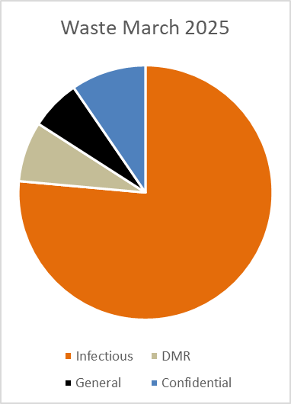
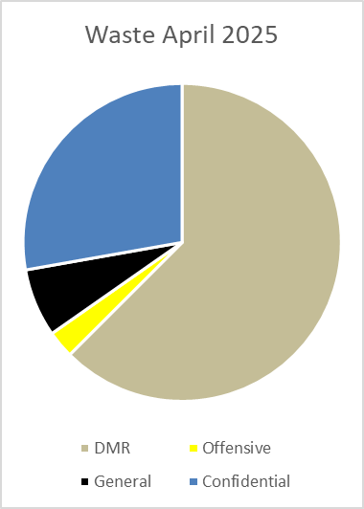

Waste Management in Specimen Reception – Pathology UHBW
Summary:
Successfully changed waste streams from infectious to recycling.
Objective
Review the waste management in Specimen Reception at BRI pathology with the goal of reducing the amount of waste going into infectious waste stream and implementing recycling of sample bags and request forms.
Method
An initial waste audit found an excessive number of bins and little choice of waste stream. The bins at workstations contained a mix of patient request forms, sample bags, labels & gloves. An opportunity to divert most of the waste into dry-mixed recycling was identified. All stakeholders were engaged – IPC, trust waste management, H&S, specimen reception staff team, facilities staff. A risk assessment was drawn up. Average daily weight of workstation bins totalled 6kg pre-change.
Change implemented – reduced number of bins at workstations from 11 to 6 and set up bin area. Removed infectious waste bags and replaced with recycling bags. Bins were weighed and visually checked daily for one month to monitor compliance.
Results*
Over the month 11/3/25 - 11/4/25 there was a total of 84kg of soft plastics waste. This is an average of 4kg every day or roughly 1.5 tonnes per year. This would have previously gone into the infectious waste stream for incineration along with the request forms, other confidential waste and random bits of waste. Confidential waste is now also being recycled (first shredded) and an extra waste console installed to accommodate this increase. The bin area has also been reviewed and is clearly labelled with informative signs. Financial savings are estimated at approx. £700/year for waste disposal.
Calculated carbon footprint was previously 1200kg/CO₂e per annum, with the change to primarily recycling, this is now 400kg/CO₂e per annum.
Reduction in
number of bins
at workstations
Pre-change Post-change
11
infectious
6
recycling
Next Steps / Conclusion
Spot checks have been completed and continue over the coming months to check we maintain our high level of compliance.
Continuing to branch out into other departments, starting with Blood Transfusion to do the same.
*Results calculated using Carbon Footprint calculator:
The carbon footprint of waste streams in a UK hospital - ScienceDirect
Project Team: Catherine Spence, Nick Veasey
Date: July 2025
Produced by: Project Team
Find our pathology sustainability case studies on the West of England Pathology Network Futures site

