Slide 1



Elimination of single-use plastic cups and spoons in medication rounds – Sustainability in Quality Improvement project
Monika Hornakova
Sustainability Manager

Slide 2
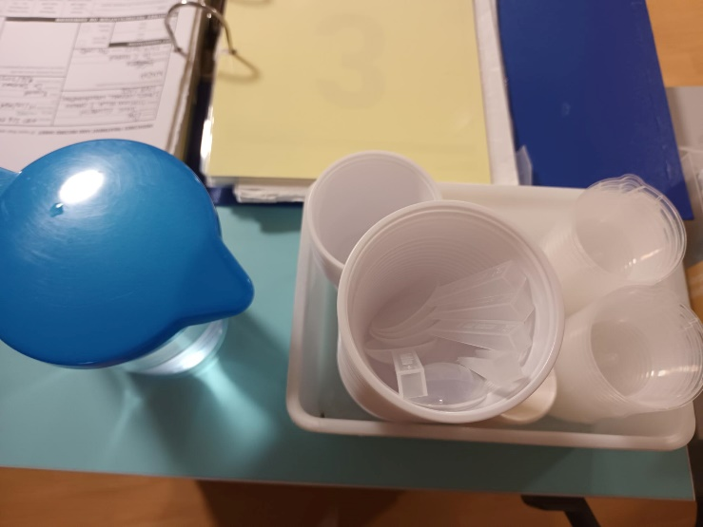
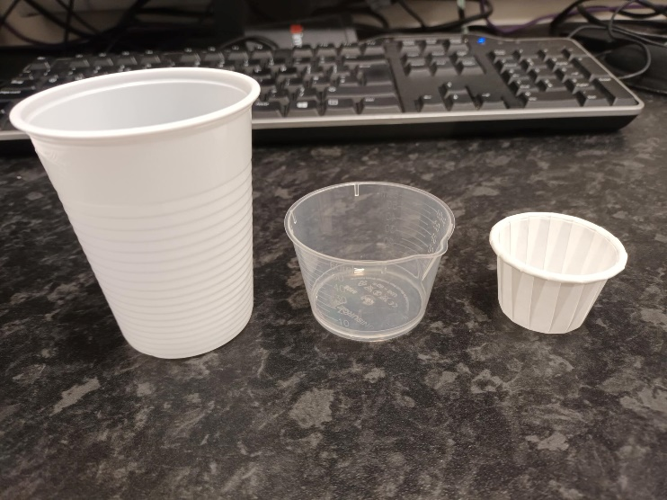
Background
SusQI project on 12 bed eating disorder ward
Medication rounds 4 times per day
29,200 single use plastic cups and spoons annually
Approximately 146kg of single use plastic cups and spoons disposed of annually
Notes:
Sust. Champions – concerns- SU plastics; recognised opportunity
At the end – what is SusQI, how to join, Aspiring beacon site, Centre for Sust. Healthcare at the end

Slide 3
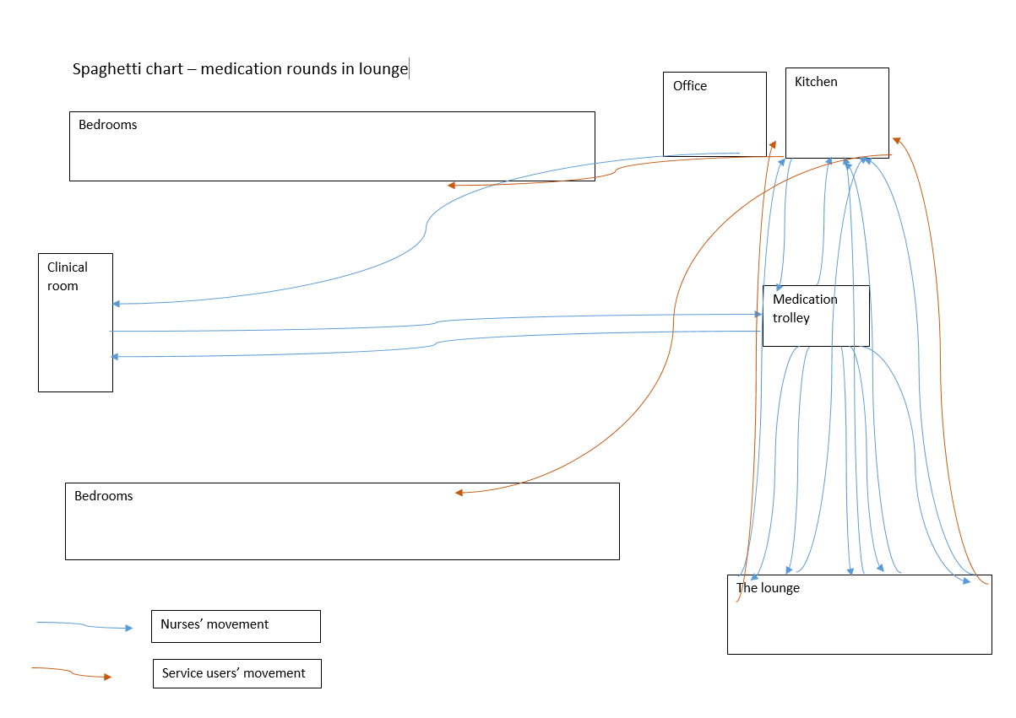
Observations
When the ward was visited, it was observed that patients have access to reusable mugs, water bottles, reusable clear plastic cups, reusable spoons, and reusable pots. All can be washed in dishwasher.

Slide 4
Waste
Time: nurses time, administration time, unpacking
Processing: over processing (pouring water, cups)
Motion: staff walking distance
Over production: extra cup, staff walking, extra water
Inventory: material waste, A/C energy, cups on shelf, water
Defects: temperature in clinical room - SU too cold
Underutilized talent: no value added activities
7 Wastes
Notes:
Processing (over processing) – extra cup, pouring water
Time – nurses time: filling a jug with water, pouring water in a cup, disposing of a cup, administration time when ordering cups (waste of time when the products is not in stock), unpacking order and placing on shelfs and then trolley.
Over production – extra cup of water, nurses walking when disposing of the cups,
Inventory: energy in clinical room, wasted water (supplied– via tap and used/water treated/in the sink), cups purchased, cups on shelf, cups in a general waste bin
Material waste: energy, water, cups – waste
Defects – temperature in clinical rom; SU too cold

Slide 5
Specific aims
Replacement of single-use plastic cups and spoons with re-usable alternatives
Single use plastics contribute to air pollution which is public health concern.
Single use plastic pollution is also a priority within MPFT’s Green Plan.
Triple bottom line (social, environmental and financial impact).
The reduction of greenhouse gases emissions.
Reduction of Staff’s time
Cost savings
Patients upset about impact of single use plastic

Slide 6
Methods
Plan
Define objective, questions and predictions.
Ask Who? What? Where? When? Why? How?
Plan data collection, site visits, idea form, discussion with patients and staff
Support from the ward
Act
Do
Plan the next cycle
Decide whether the change can be implemented
Carry out the plan
Test on the event – 30 days measurements
Collect the procurement data and data from site visits (time observation)
Begin analysis of the data
Study
Complete the analysis of the data
Compare data to predictions
Summarise what was learned
Notes:
Project originally too big, it needed to narrow down to 1 product and one team.

Slide 7
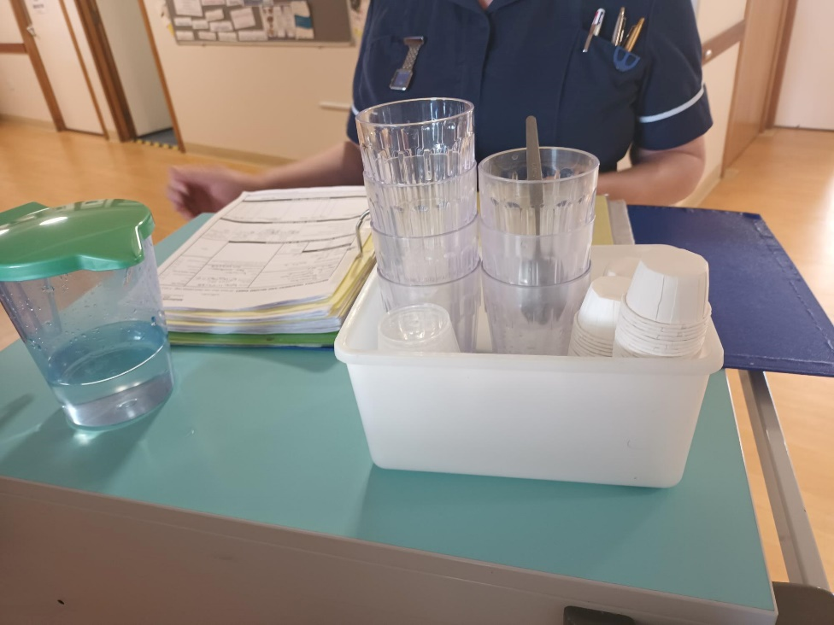
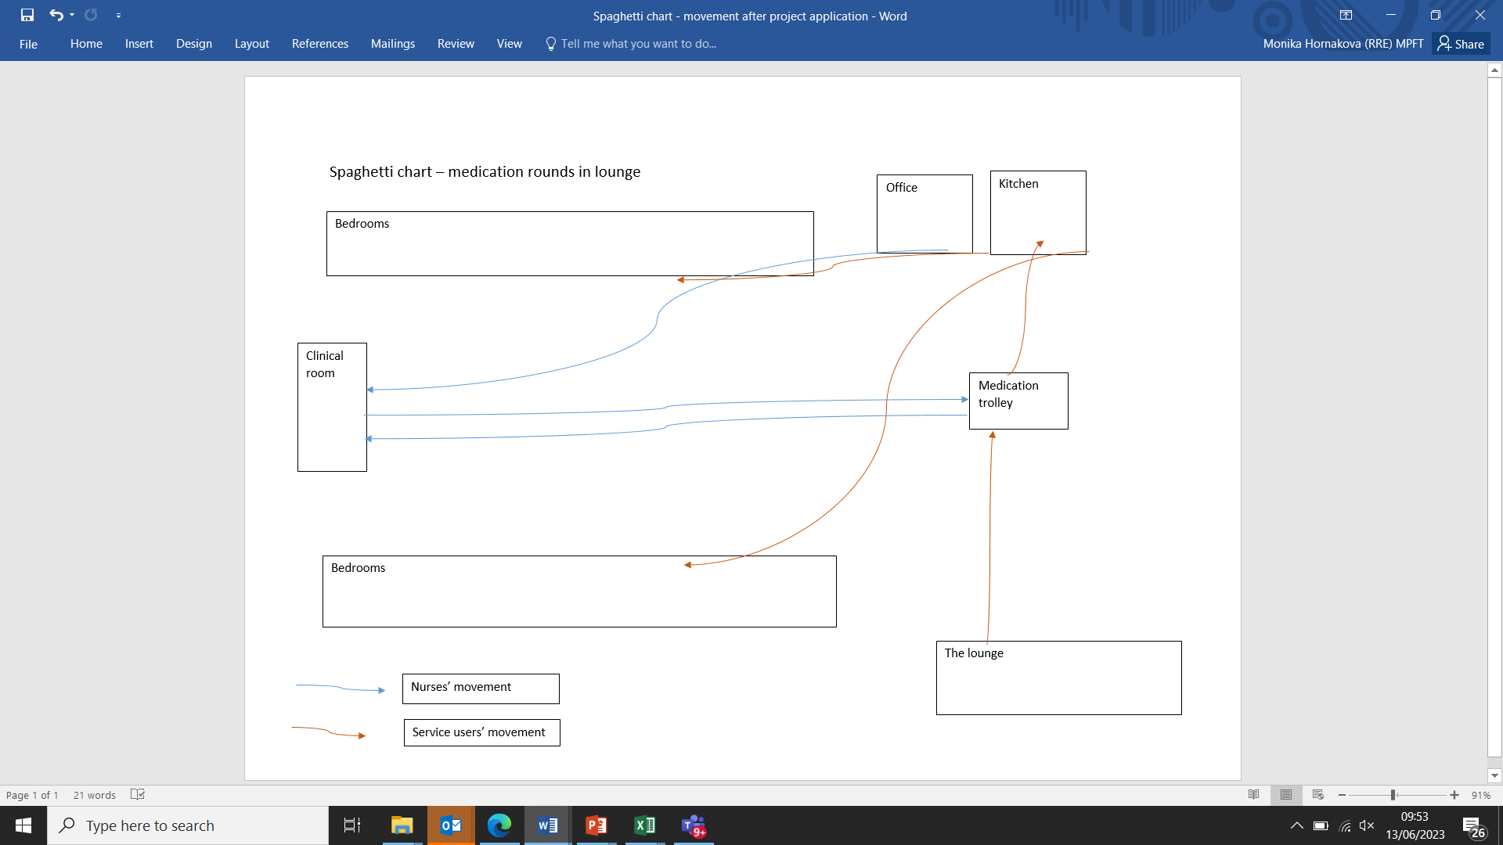
What we actually did?
Single-use plastic cups and spoons replaced with reusable spoons and cups at £0 cost
Patients brought their water bottles/cups/mugs to medication rounds
Patients walked to the medication trolley
Notes:
29,200 single use plastic cups and spoons were replaced with reusable dishwasher safe cups and metal spoons, all at 0 cost

Slide 8
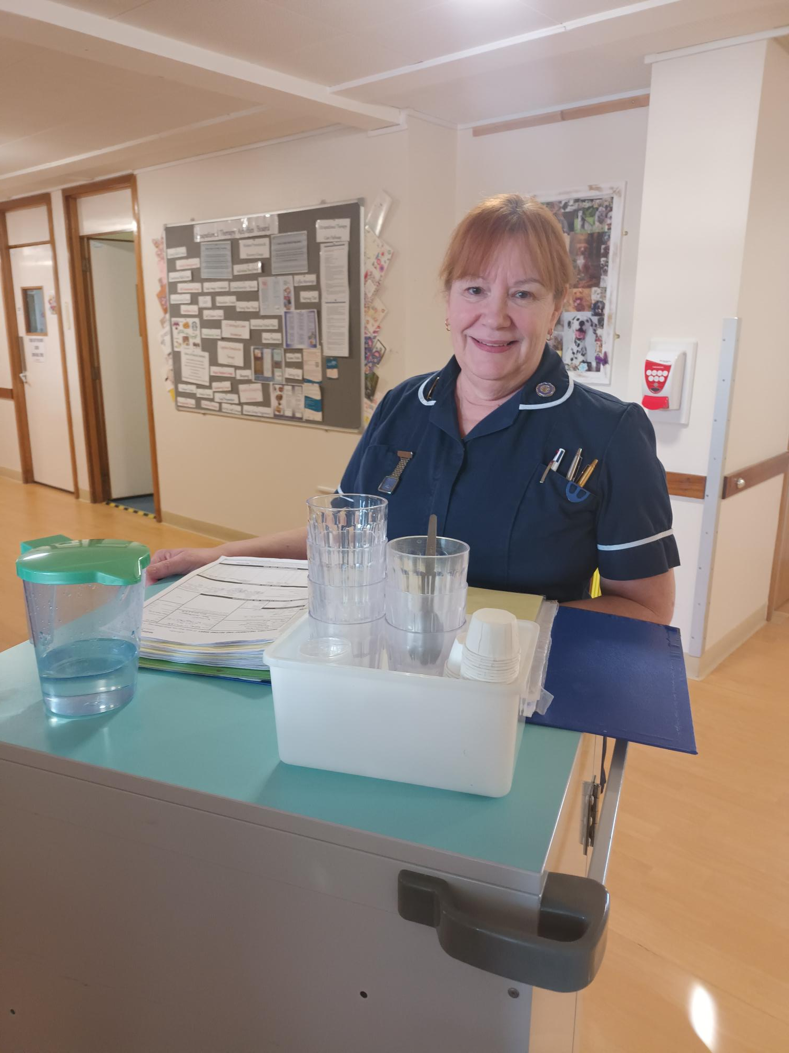
Outcome highlights
Environmental:
  29,200 SU plastic cups and spoons reduced to 0,
  Reduced energy consumption from A/C units, water consumption,
  Reduced carbon footprint,
Financial:
  savings on energy and water bill,
  purchase of cups, spoons and
  staff’s time,
Social:
  Decreased staff time spent on no value added activities,
  Patients normalization, empowerment, ‘what they would do at home’,
  Positive feedback: Happier and less tired staff,
  Clinical outcomes: less mistakes, no value added activity time re-invested in patient care.
Notes:
246 litres of water saved (supplied and drained)
Just under 3,600kWh energy saved from increasing temperature of A/C unit in a clinical room

Slide 9
Measured outcomes - how do we know our change is an improvement?
Impact | Metric | Baseline measure (pre SusQI) per day | Outcome measure (post SusQI) per day | Annual savings
Environmental | GHG emissions (energy, water, material and waste) | 8.75 kgCO2e/day | 5.5 kgCO2e/day | 1,186.25 kgCO2e
Financial | Energy consumption, water cost and purchase of single use plastic cups and spoons | £7.8/day | £2.2 per day | £842 per year
Financial | Inventory | £543.65 annually | £102.73 annually | £440.92 annually
Social | Staff time | 6.25 minutes per 1 medication round | 3.8 minutes per 1 medication round | 45 hours (6 shifts)
Social | Staff walking distance | 32 metres per patient | 0 | 87 miles
Notes:
We reduced energy consumption from A/C being set to 18 d.C every day all day in a clinical room where they stored medicine and patients received medication once a day; water consumption; and reduced number of cups and spoons. Environmental: per day: 3.25kgCO2e
Financial:
Social: staffs time: 2.48 minutes per medication round
Staff walking distance – 87 miles, return journey from Trentham estate to Birmingham new street
Explain lead time
Social:
lead time – baseline: 6 min per; target: 3 min per …
staff walking time,
staff and patients feedback
Environmental:
energy consumption,
water wasted,
GHG emissions
Financial:
Inventory cost,
energy and water cost.

Slide 10
Lessons learnt
Trust the process
More than 1 site visit
Fresh pair of eyes within clinical environment
When implementing change – what makes them tick?

Slide 11
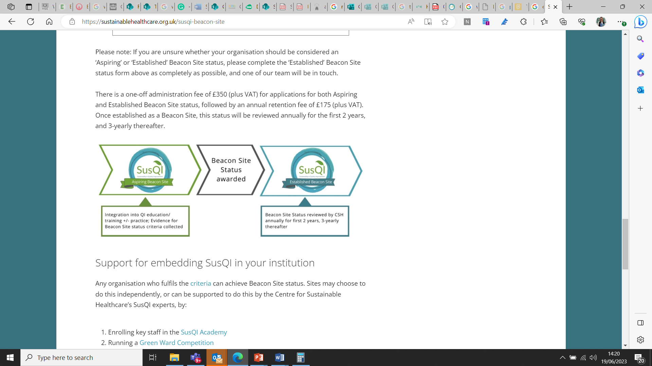
Next steps
Rolling out across MPFT
Potential replacement of clear single use plastic pots by reusable syringes in medication rounds and tube feeding
Involving patients on eating disorder ward in sustainability discussions – role of Sustainability Champions and co-production of Green Awards
The Royal College of Nurses Awards – Green wards application
1 step closer to progress from Centre for Sustainable Healthcare’s ‘Aspiring Beacon site’ to ‘SusQI Beacon site’ recognition

Slide 12
Thank you

