Slide 1
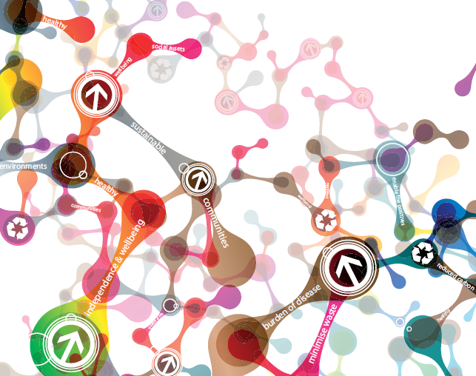
Sustainable, Resilient,
Healthy People & Places:
The SDU Strategy in
Occupational
Therapy
Caroline Jessel
NHS England Lead for South Network for Sustainability and Health
2nd July 2015 COT Annual Conference
Notes:
About the unit
Drivers for change
The strategy

Slide 2
Plan for the session
11.10 Introductions
11.15 Overview - the national strategy and the big picture
11.30 What does this mean for occupational therapists?
11.45 Where are we now with creating a sustainable health and care system?
12.15 Plans shared and discussed
12.35 Next steps and summing up
12.40 Close

Slide 3

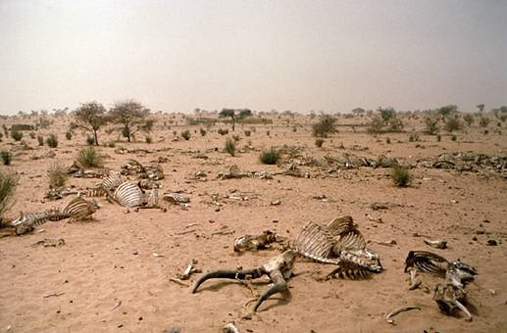
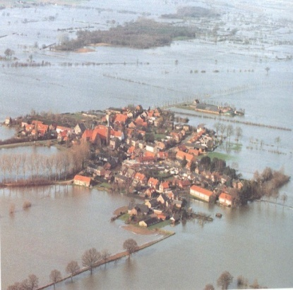
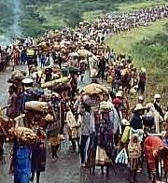
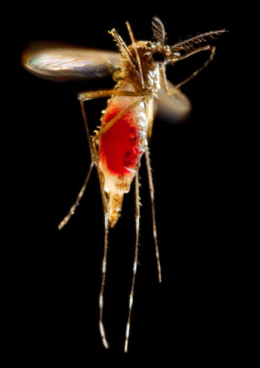

A health issue?
Notes:
Criteria to be able to deal w a world of low carbon , higher population, low or no oil, and improved technology

Slide 4
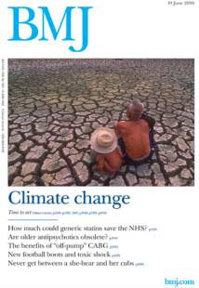
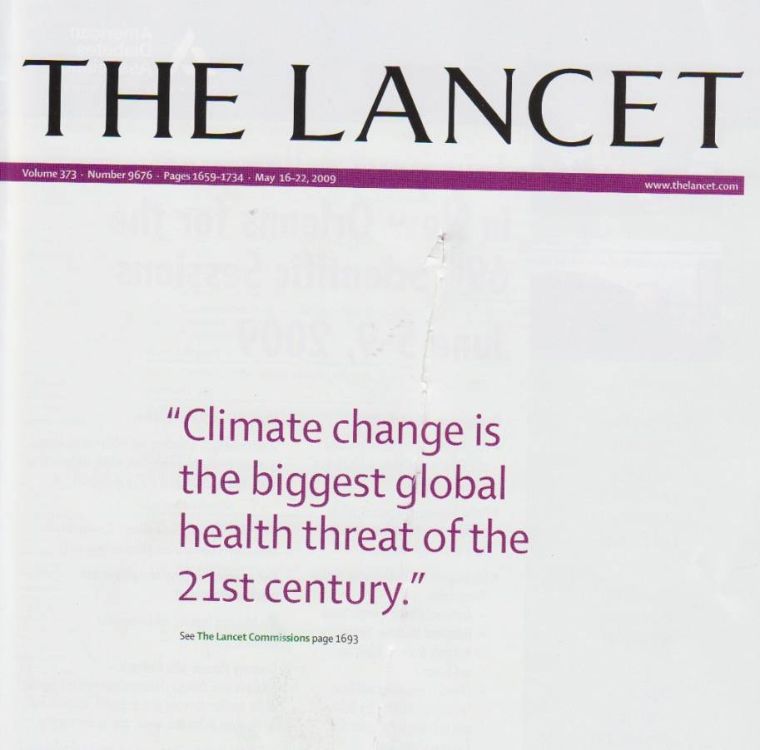

Slide 5

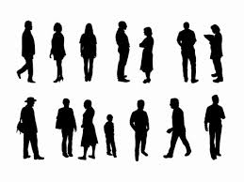

Health is a vital resource for our country
Being productive
81% of Britons believe that Government should prioritise creating the greatest happiness, not the greatest wealth
Healthy People
A virtuous circle
Building a strong society
Notes:
Opinion bubble reference – NEF 2013

Slide 6
What is sustainable development?
“Development that meets the needs of the present without compromising the ability of future generations to meet their own needs”
(Brundtland Commission 1987)
Social
Sustainable development
Environmental
Economic

Slide 7
Health and sustainability: a common agenda
Barton and Grant
Notes:
The Barton and Grant conceptual model highlights the importance of the wider determinants on health
Source: Barton H, Grant M (2006). A health map for the local human habitat. Journal for the Royal Society for the Promotion of Health, 126 (6). 252-253

Slide 8
We know what the fundamental causes of ill-health are…
Health and wellbeing are the work of a lifetime
They do not happen by chance
Health must be promoted all through life
The building blocks of good health
Good education
Safe Environment
Sense of purpose
Individual behaviours
Strong community
Decent housing
Meaningful work
Adequate income

Slide 9
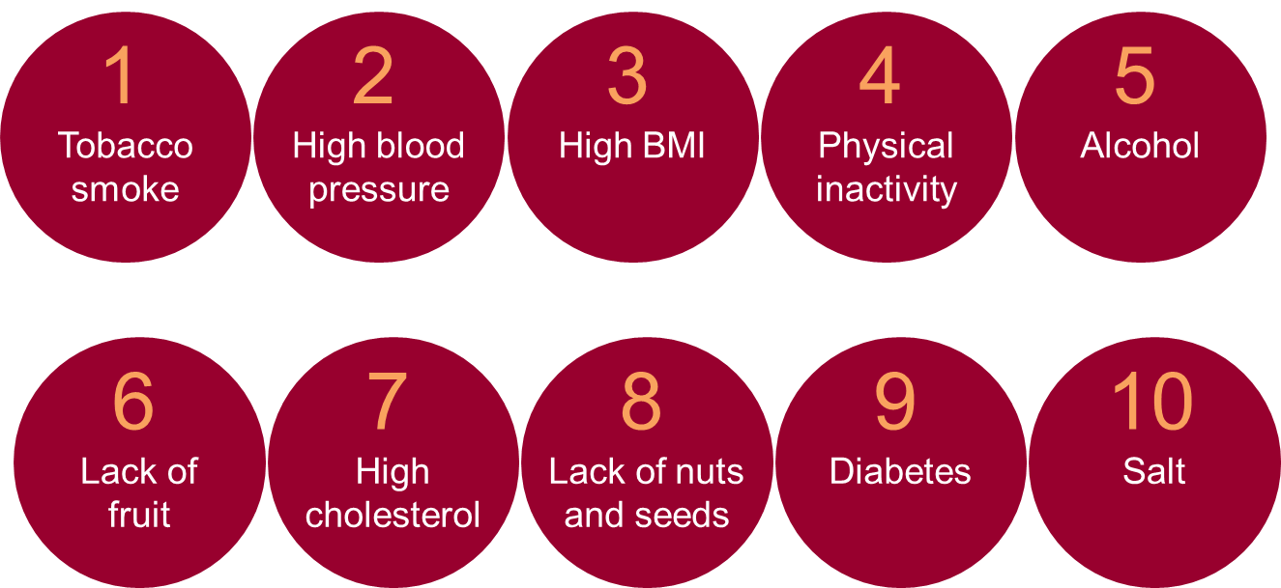
…and they align with the immediate causes of ill health…
Overweight & obesity
Top 10 contributors to years of life lived with disability
Notes:
Source – Global Burden of disease

Slide 10
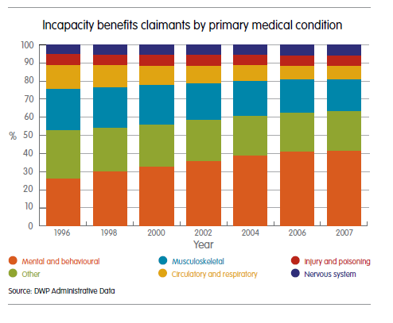
…which contribute to the main forms of disability…
The main forms of disability map exactly to incapacity benefits – mental illness and musculoskeletal come out on top
Musculoskeletal disorders
Mental illness
Diabetes
Chronic respiratory diseases
Neurological disorders
Unintentional injuries
Cardiovascular disorders
Cancer
Notes:
Source – Global Burden of disease, DWP administrative data
Why is our mental health deteriorating?

Slide 11
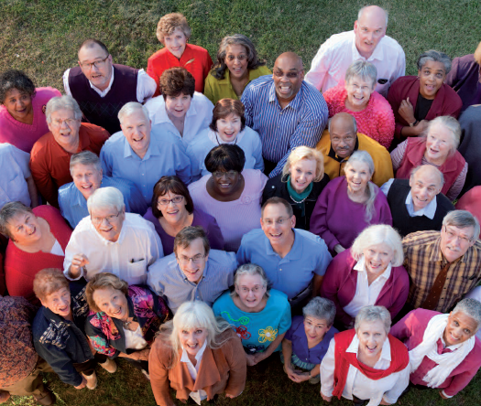
The Public’s view
Ipsos MORI 2011 and 2013
89% thought it important or very important for health system to be more sustainable
36% said it should even if cost more money
Notes:
Ipsos MORI research - the public's view
In September 2013, the Sustainable Development Unit commissioned Ipsos MORI to carry out a public opinion survey to establish what the public’s expectation was in relation to sustainability in the health and care system. This builds on a similar survey that was carried out in 2011 in relation to the NHS. Each survey comprised close to 1000 interviews.
Headline summary of responses:
The survey shows that the public continues to think that sustainability remains an important issue for the health system.
The percentage of the public who think it is important for the health system to work in a more sustainable way remains high 89% in 2013 (2011 survey results for NHS only were 92% in 2011)
The percentage of the public who said the health system should act in a more sustainable way even if it would cost more money is 36% in 2013 (and was 33% in 2011).
When asked to state how high priority sustainability should be in the health system the responses remain consistent with 19% (around 1 in 5) saying it should be a top priority.

Slide 12

Notes:
Based on a strong consultation (Close to 1000 responses - 55% NHS Trusts – 35% of CCGs and CSUs and 31% of all LAs) that defined the areas of focus.
5 modules launched in 2014. 3 additional ones for 2015 – hence todays focus on the deep dive.
Involves working right across the health and social care system – hence the development of networks for sustainability

Slide 13
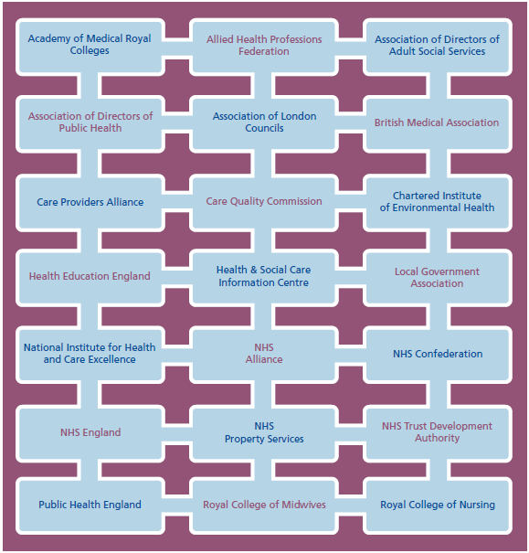
Cross system support

Slide 14
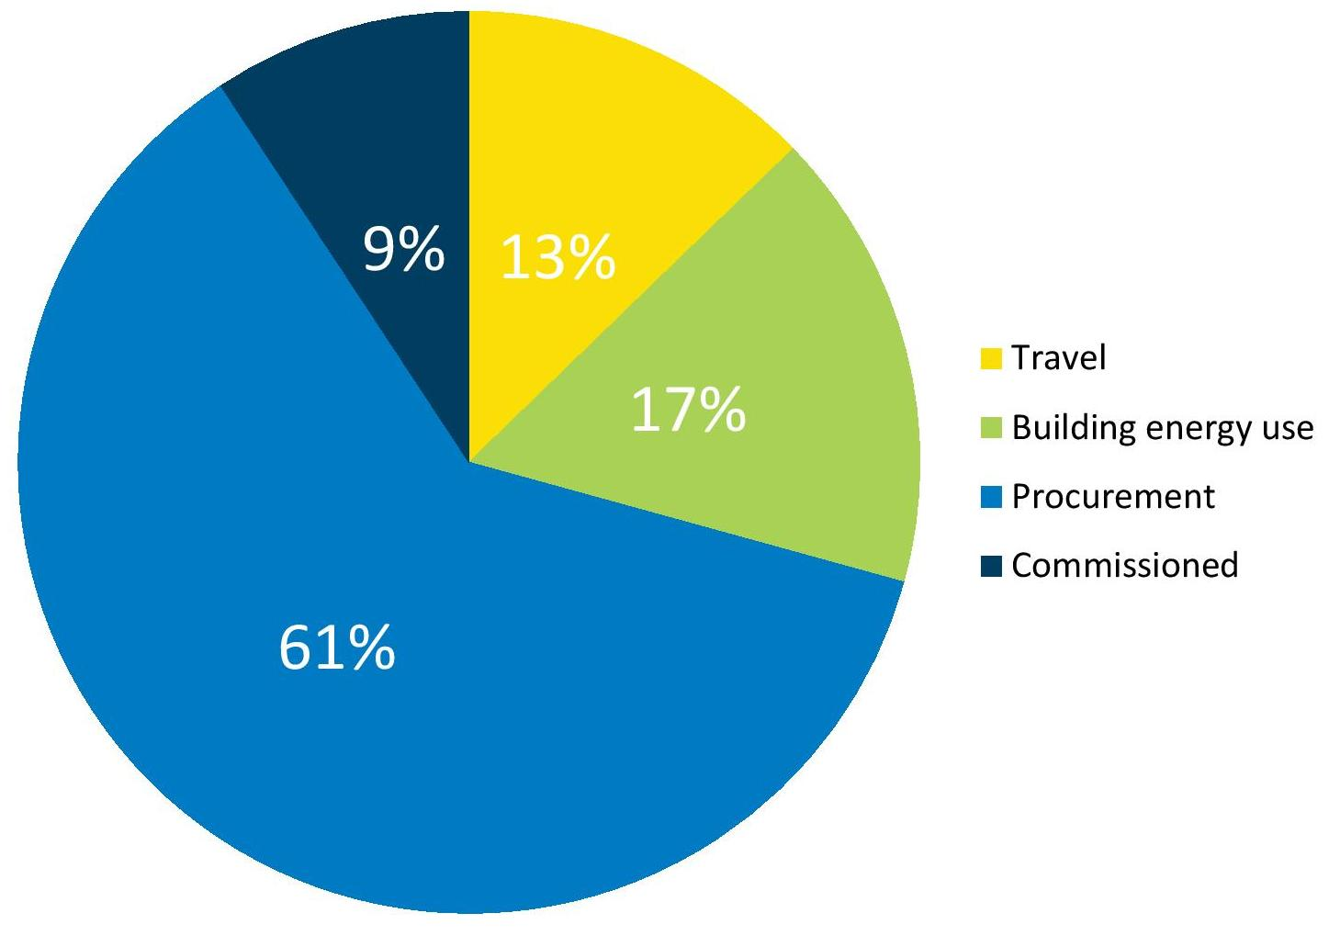
NHS CARBON FOOTPRINT 2012

Slide 15
8 supporting modules
Metrics
Carbon hotspots
Commissioning and procurement
Creating social value
Healthy sustainable and resilient communities
Innovation and technology
Leadership, engagement and workforce
Sustainable care models
Notes:
Social value- Marmot and the Social Value Act - example dementia friendly towns
Communities - adaptation and resilience – adaptation plans
Care models – high quality low cost and low carbon –how? Integration, more focus on prevention and optimal use of technology –see 5YFV

Slide 16

Vision for sustainable health and care
A sustainable system that protects and improves health within environmental and social resources now and for the future
Notes:
Goal 1:
A healthier environment
A healthier environment can contribute to better outcomes for all. This involves
valuing and enhancing our natural resources, whilst also reducing harmful
pollution and significantly reducing carbon emissions. Contributing to the
Climate Change Act target with a 34% reduction in carbon emissions by 2020 is
a key measure of our ambition across the country.

Slide 17
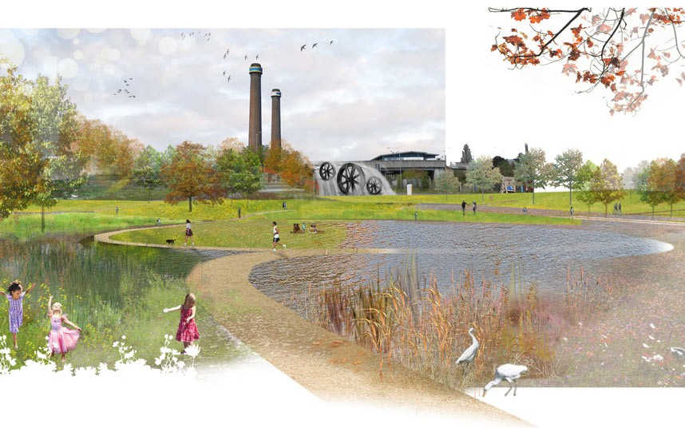
Goal 1
A healthier environment

Slide 18
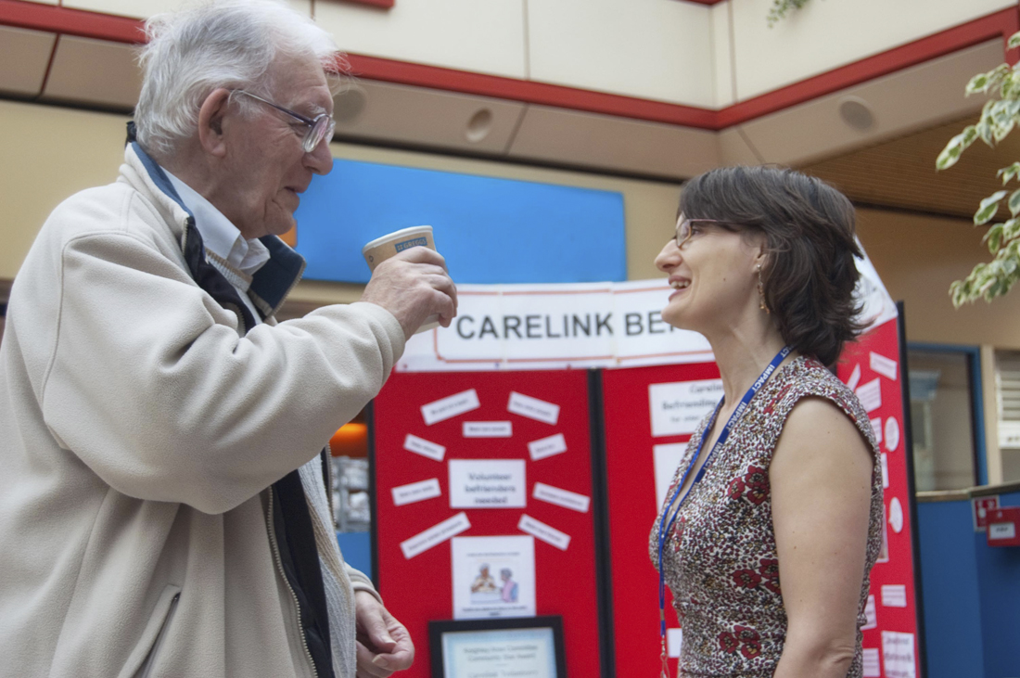
Goal 2
Communities and services are resilient to changing times and climates
Notes:
Goal 2:
Communities and services are ready and resilient for changing times and
climates
When periods of heat, cold, flooding and other extreme events occur it is
vulnerable people and communities that suffer the worst. Those communities
and their services bear the responsibility of addressing the consequences of these
events. Multi-agency planning and organisational collaboration, underpinned by
local plans and assurance mechanisms, provide a better solution to these events
than working independently, individually and ineffectively.

Slide 19
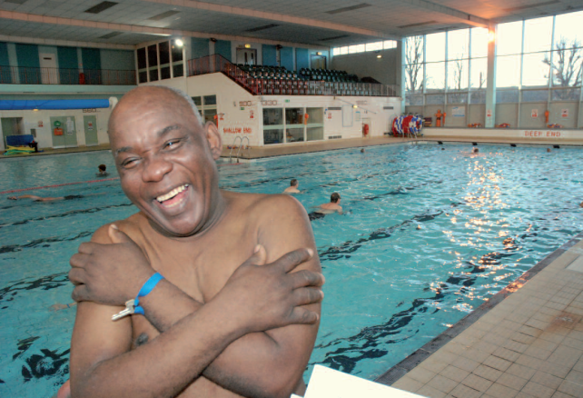
Goal 3 Every opportunity contributes to healthy lives, communities and environments
Notes:
Goal 3:
Every opportunity contributes to healthy lives, healthy communities and
healthy environments
Every contact and every decision taken across the health and care system can
help build the immediate and longer term benefits of helping people to be well
and reduce their care needs. There are multiple mechanisms that can support
this approach from improved information, more integrated approaches and
smarter more aligned incentives that help minimise preventable ill-health, health
inequalities and unnecessary treatment. A sustainable system cannot be
achieved without taking every opportunity to support communities and people
to be independent and self-manage conditions and events.

Slide 20
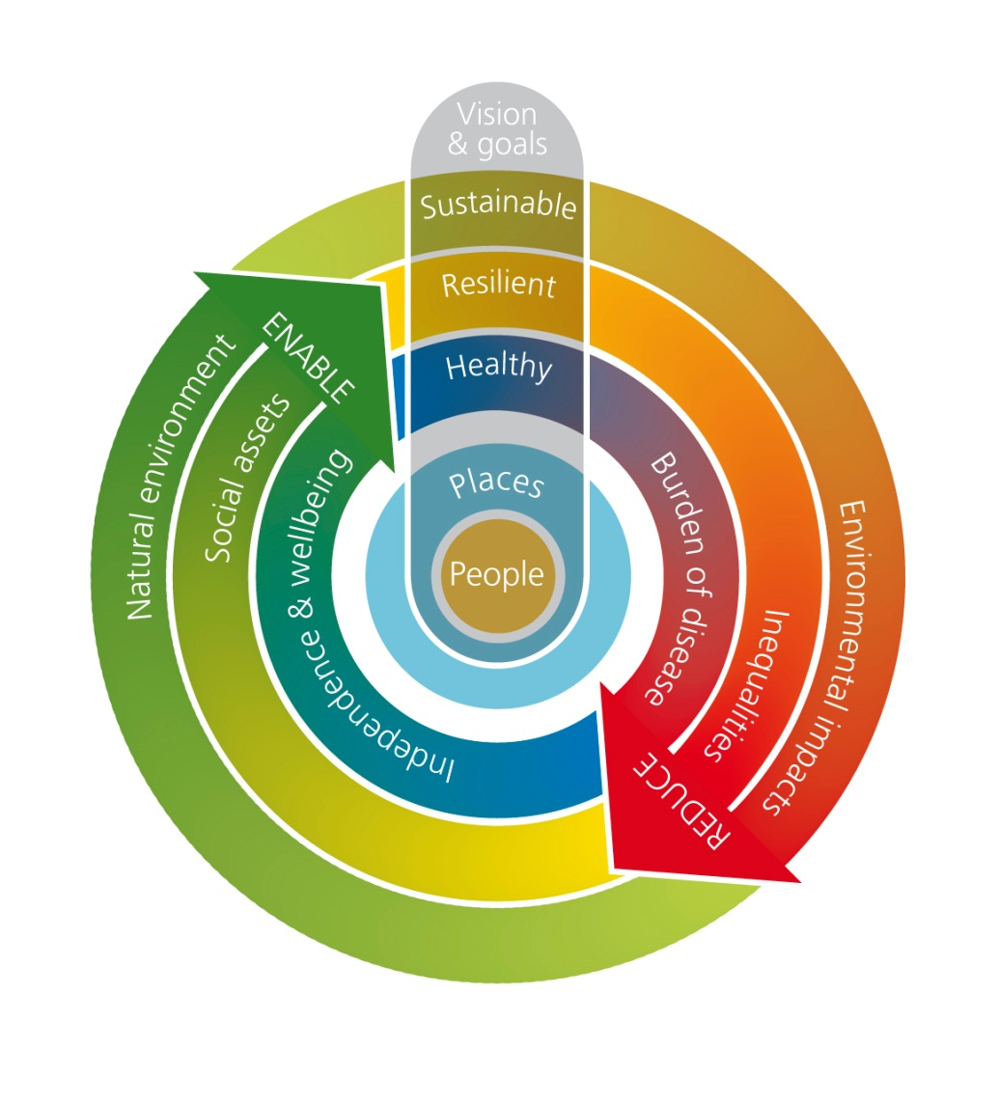
A sustainable health and care system
Reduce the negatives
Enable the positives

Slide 21
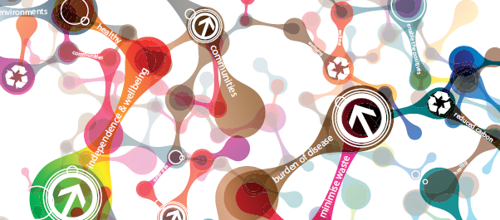
Results
Reduced environmental impact
Prepared communities
Local community leadership
Embedding sustainability
Improved health outcomes
Recognition and replication
Notes:
Reduced environmental impact: meet or exceed the target of a 34% reduction CO2e emissions by 2020. This would
leave the system well placed to meet the 50% target by 2025.
2. Prepared communities: organisations and local communities can be well prepared for the impacts of climate change and
have plans in place to deal with events such as heatwaves, flooding and cold snaps. Progress will be highlighted in the
Sustainable Development Unit report on adaptation for the health and care sector under the Adaptation Reporting
Power16 as well as a series of actions set out in the National Adaptation Programme18 published in July 2013.
3. Local community leadership: Health and Wellbeing Boards can develop strong and proactive Health and Wellbeing
Strategies within new and existing services that integrate the principles of sustainable development to achieve public
health and sustainable development outcomes and can be reviewed on a regular basis.
4. Embedding sustainability: decision making processes can take account of sustainability in purchasing, investment,
operational and strategic decisions, influencing the behaviour of those both inside and outside of the health and care
system.
5. Improved health outcomes: measurable progress is made against national NHS, Public Health and Social Care Outcomes
Frameworks19.
6. Recognition and replication: the public can be proud of our efforts made

Slide 22

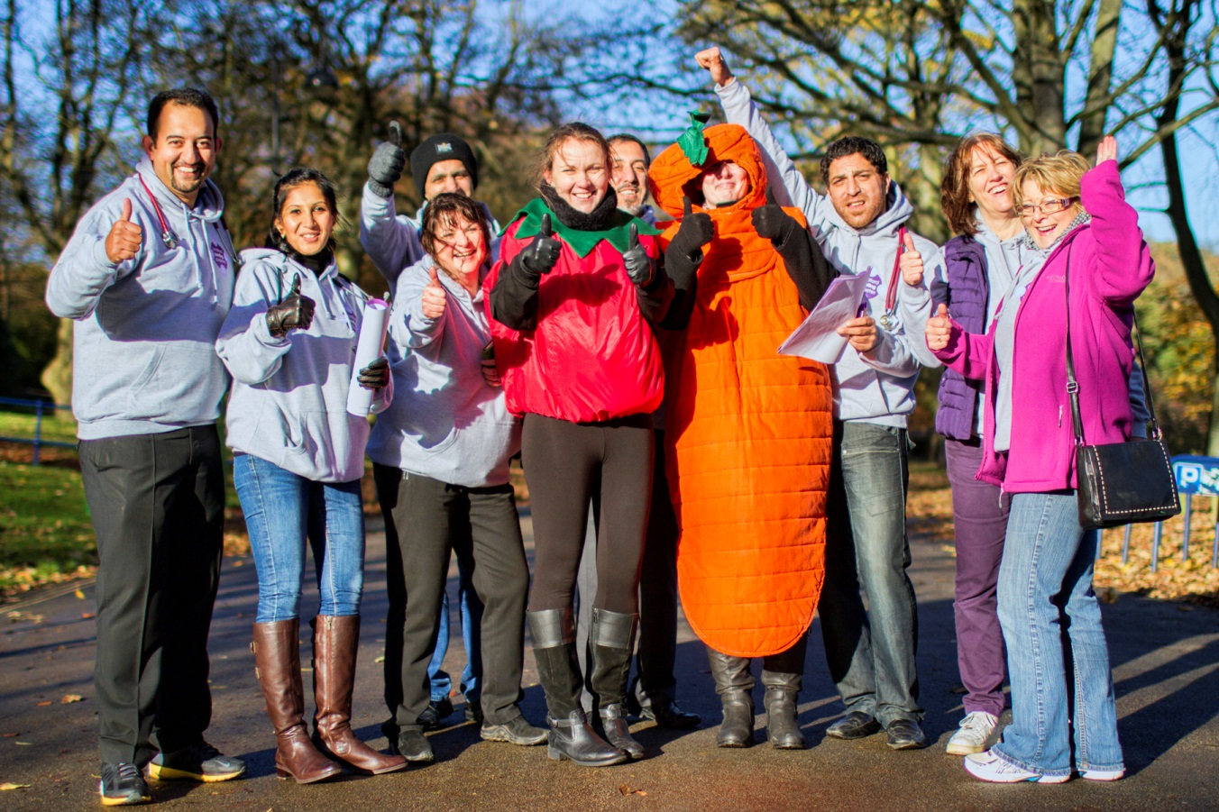
Notes:
Happier more motivated staff

Slide 23
Network for
Health and Sustainability
South region wide
Part of national strategy
Cross system membership
Developing local networks
Regular masterclasses and annual conference
Developing sustainability leadership programme

Slide 24
Thank you
cjessel@nhs.net
to join network

Slide 25
Plan for the session
11.10 Introductions
11.15 Overview - the national strategy and the big picture
11.30 What does this mean for occupational therapists?
11.45 Where are we now with creating a sustainable health and care system?
12.15 Plans shared and discussed
12.35 Next steps and summing up
12.40 Close

Slide 26
Sustainable, Resilient, Healthy People & Places: The SDU Strategy in Occupational Therapy
COT Annual Conference, Brighton Centre 02/07/2015
Ben Whittaker (Occupational Therapy Programme Lead)

Slide 27
150 years
100 years
50 years
NOW
First home PC
First Oil Well
Domestic light bulb
4142 cars, 10 miles concrete road in US
First commercial jet ticket
240,000,000 home PCs
650,000,000 cars
4,800,000,000 passenger flights
4,000,000,000 bulbs pa EU+USA alone (that’s 126 a second)
(Montgomery 2009)
Notes:
You’ve had the overview from Caroline. I like this summing up

Slide 28

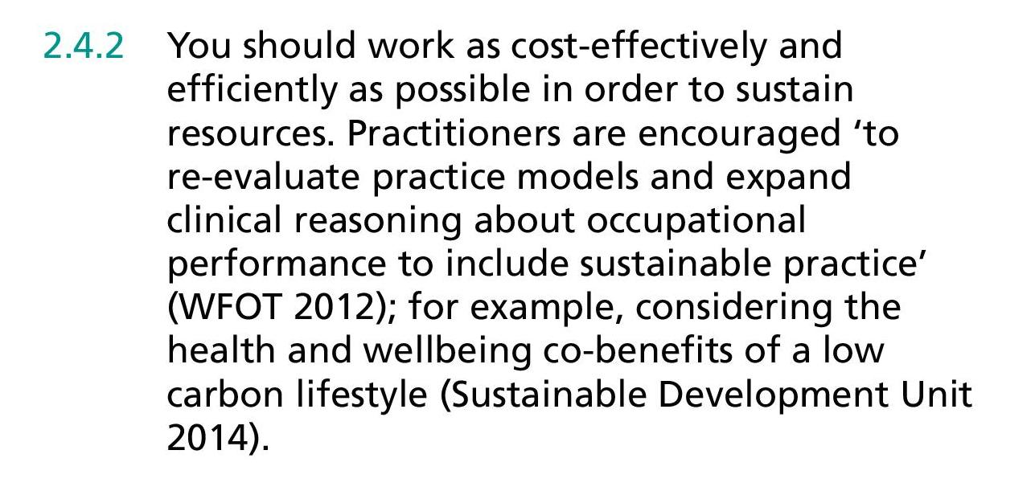
COT CODE OF ETHICS AND PROFESSIONAL CONDUCT

Slide 29
outcomes
costs
value =
economic
social
environmental
Notes:
Slide taken from: Mortimer F (2013)

Slide 30
“We behave as we believe that other people, specific social or cultural groups or society as a whole expect us to behave”
(Hagedorn 2004, p12)

Slide 31
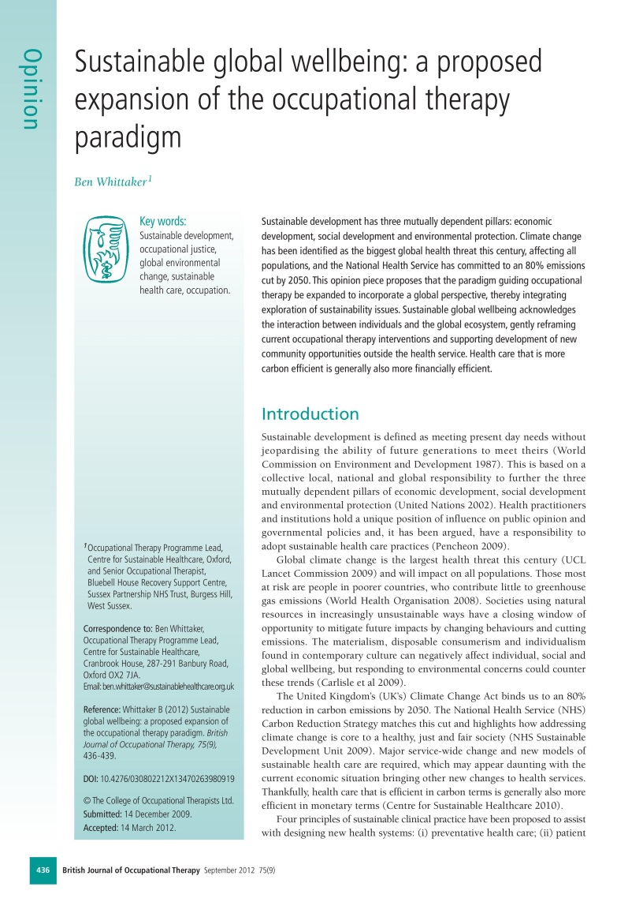
Incorporate each individual’s interdependency with the global ecosystem
Addressing global wellbeing through sustainable development can improve individual, community and social wellbeing (Whittaker 2012)
Notes:
Kind of debate. If interested in hearing more. Here’s one I prepared earlier.

Slide 32
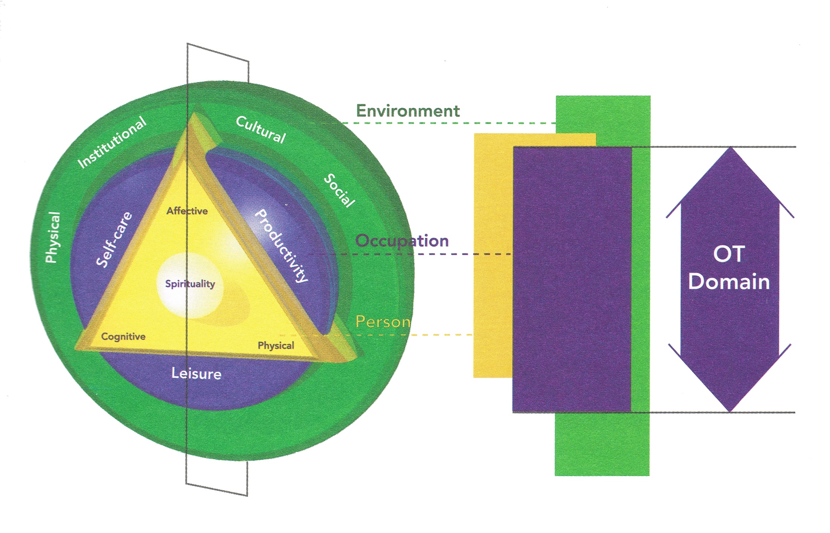
Canadian Model of Occupational Performance and Engagement (CMOP-E) (Polatajko, Townsend & Craik, 2007)

Slide 33
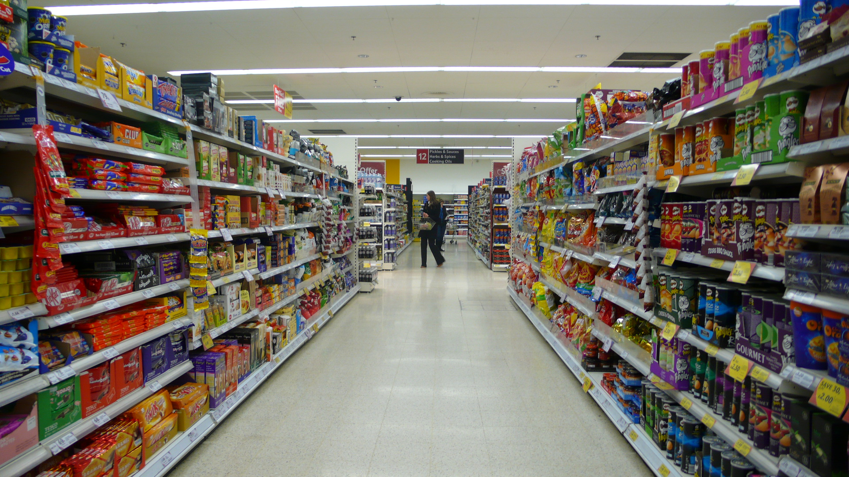
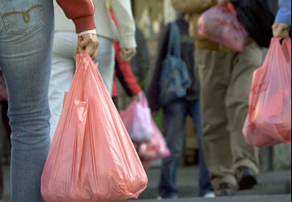

Notes:
Carrier bag use and consumption. Physical and mental health damaged as well as damage to pockets and health and environment. Have all the choices.

Slide 34
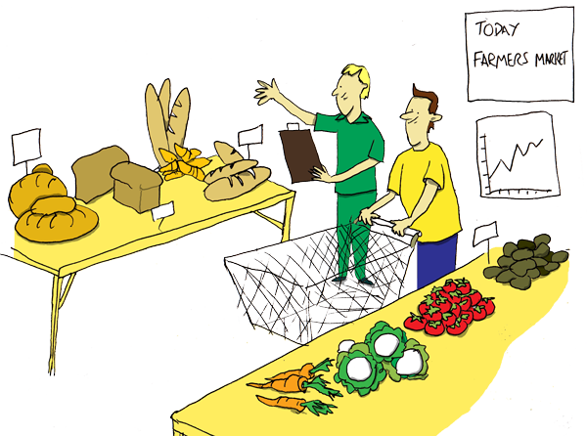
Notes:
Can’t

Slide 35
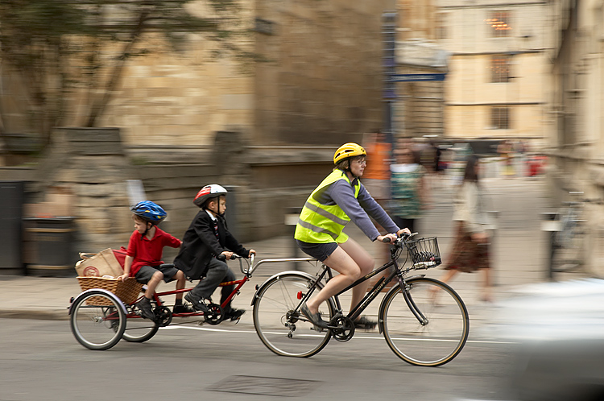
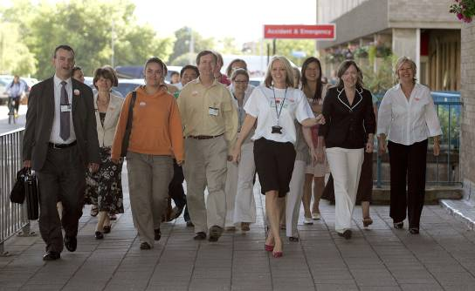


Slide 36
Promote leadership ON SUSTAINABLE PRACTICE
Principles of Sustainable Clinical Practice
Preventative healthcare
Patient empowerment and self-care
Lean and efficient service delivery
Lower carbon treatment options
(Mortimer 2010)

Slide 37
www.sap.greenerhealthcare.org

Slide 38
DEVELOP NEW COMMUNITY OPPORTUNITIES
OT process could enable people outside the health service to live more sustainably
Widespread inertia around change
  Hope
  Empowerment
  Engagement in meaningful activity

Slide 39

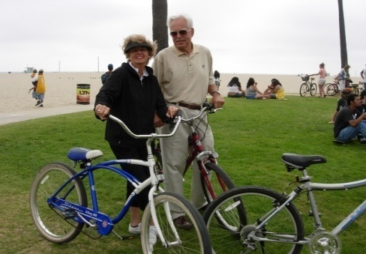


Green Lifestyle Redesign®
Camille Dieterle OTD, OTR/L
A Wellness Program for Environmental Sustainability

Slide 40
Notes:
Based on a strong consultation (Close to 1000 responses - 55% NHS Trusts – 35% of CCGs and CSUs and 31% of all LAs) that defined the areas of focus.
5 modules launched in 2014. 3 additional ones for 2015 – hence todays focus on the deep dive.
Involves working right across the health and social care system – hence the development of networks for sustainability

Slide 41
8 supporting modules
Metrics
Carbon hotspots
Commissioning and procurement
Creating social value
Healthy sustainable and resilient communities
Innovation and technology
Leadership, engagement and workforce
Sustainable care models
Notes:
Social value- Marmot and the Social Value Act - example dementia friendly towns
Communities - adaptation and resilience – adaptation plans
Care models – high quality low cost and low carbon –how? Integration, more focus on prevention and optimal use of technology –see 5YFV

Slide 42
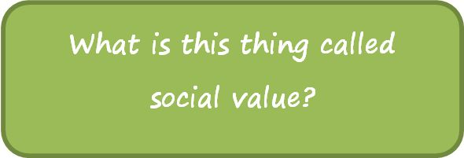

Slide 43
Healthy, sustainable and resilient communities
“Ensure that domestic as well as institutional settings are adapted, resilient and accessible”
“Individuals and communities can be equipped with the skills and tools to help them to help themselves and others, particularly the most vulnerable people in the community”

Slide 44
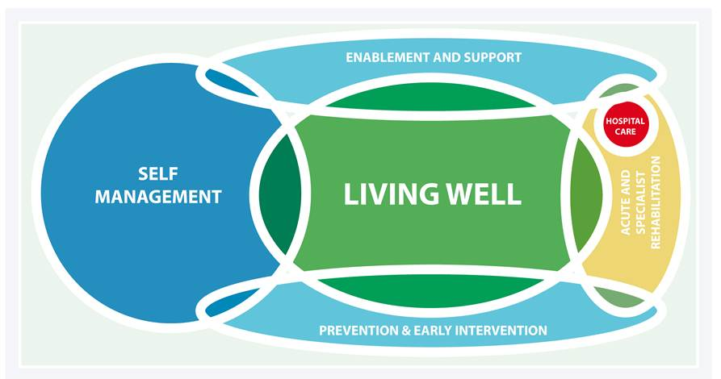
Sustainable clinical and care models
Notes:
Hospital care being a tiny bit.

Slide 45
Plan for the session
11.10 Introductions
11.15 Overview - the national strategy and the big picture
11.30 What does this mean for occupational therapists?
11.45 Where are we now with creating a sustainable health and care system?
12.15 Plans shared and discussed
12.35 Next steps and summing up
12.40 Close

Slide 46
CATEGORIES FOR YOUR IDEAS
1. Adaptation and resilience
2. Social Value
3. Carbon reduction
4. Care pathway improvement
5. Healthy living
6. Emotional well being

Slide 47



Slide 48
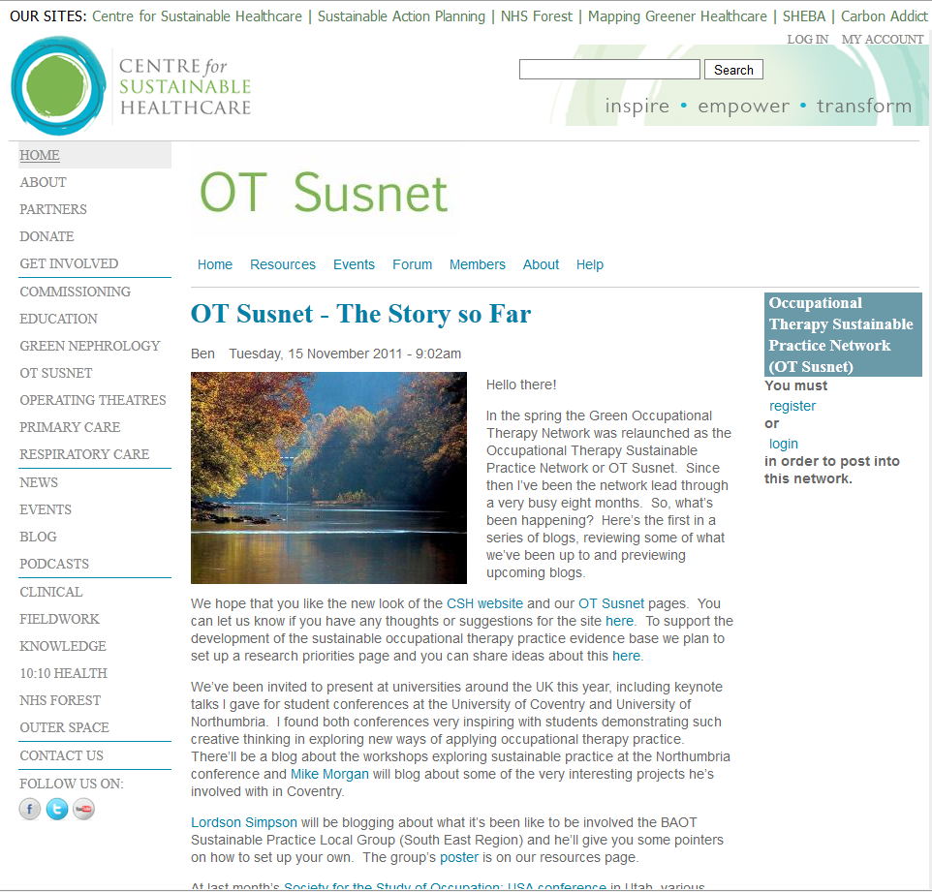

Slide 49
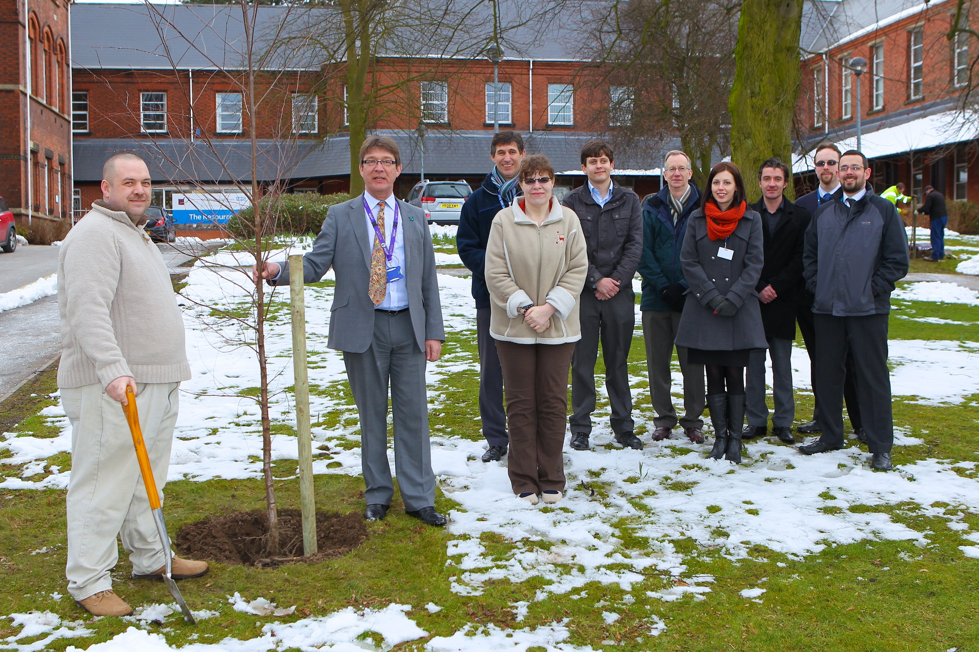
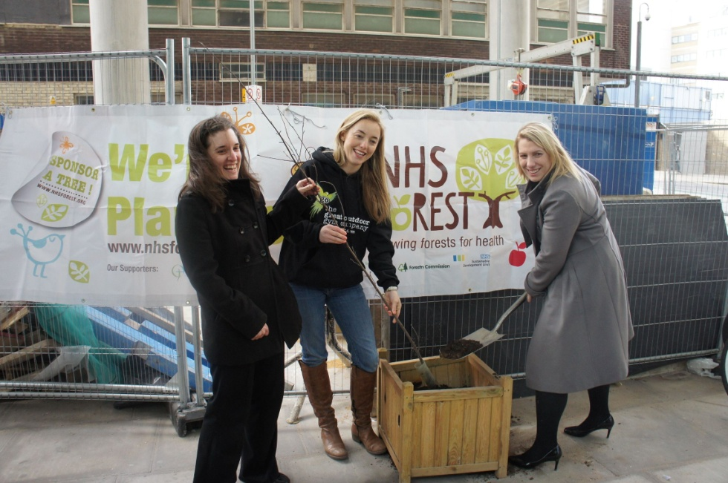
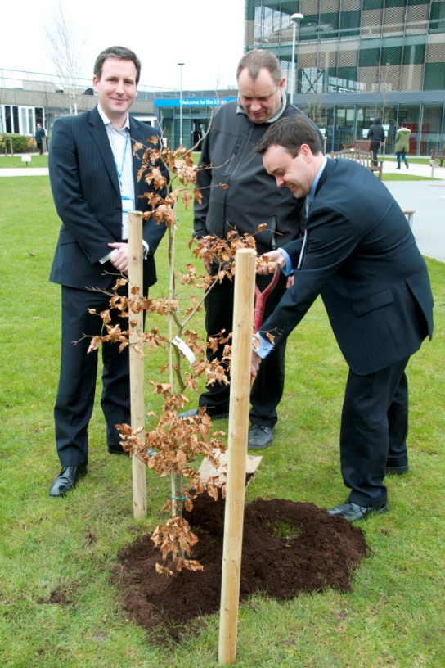


NHS Sustainability Day of Action

Slide 50
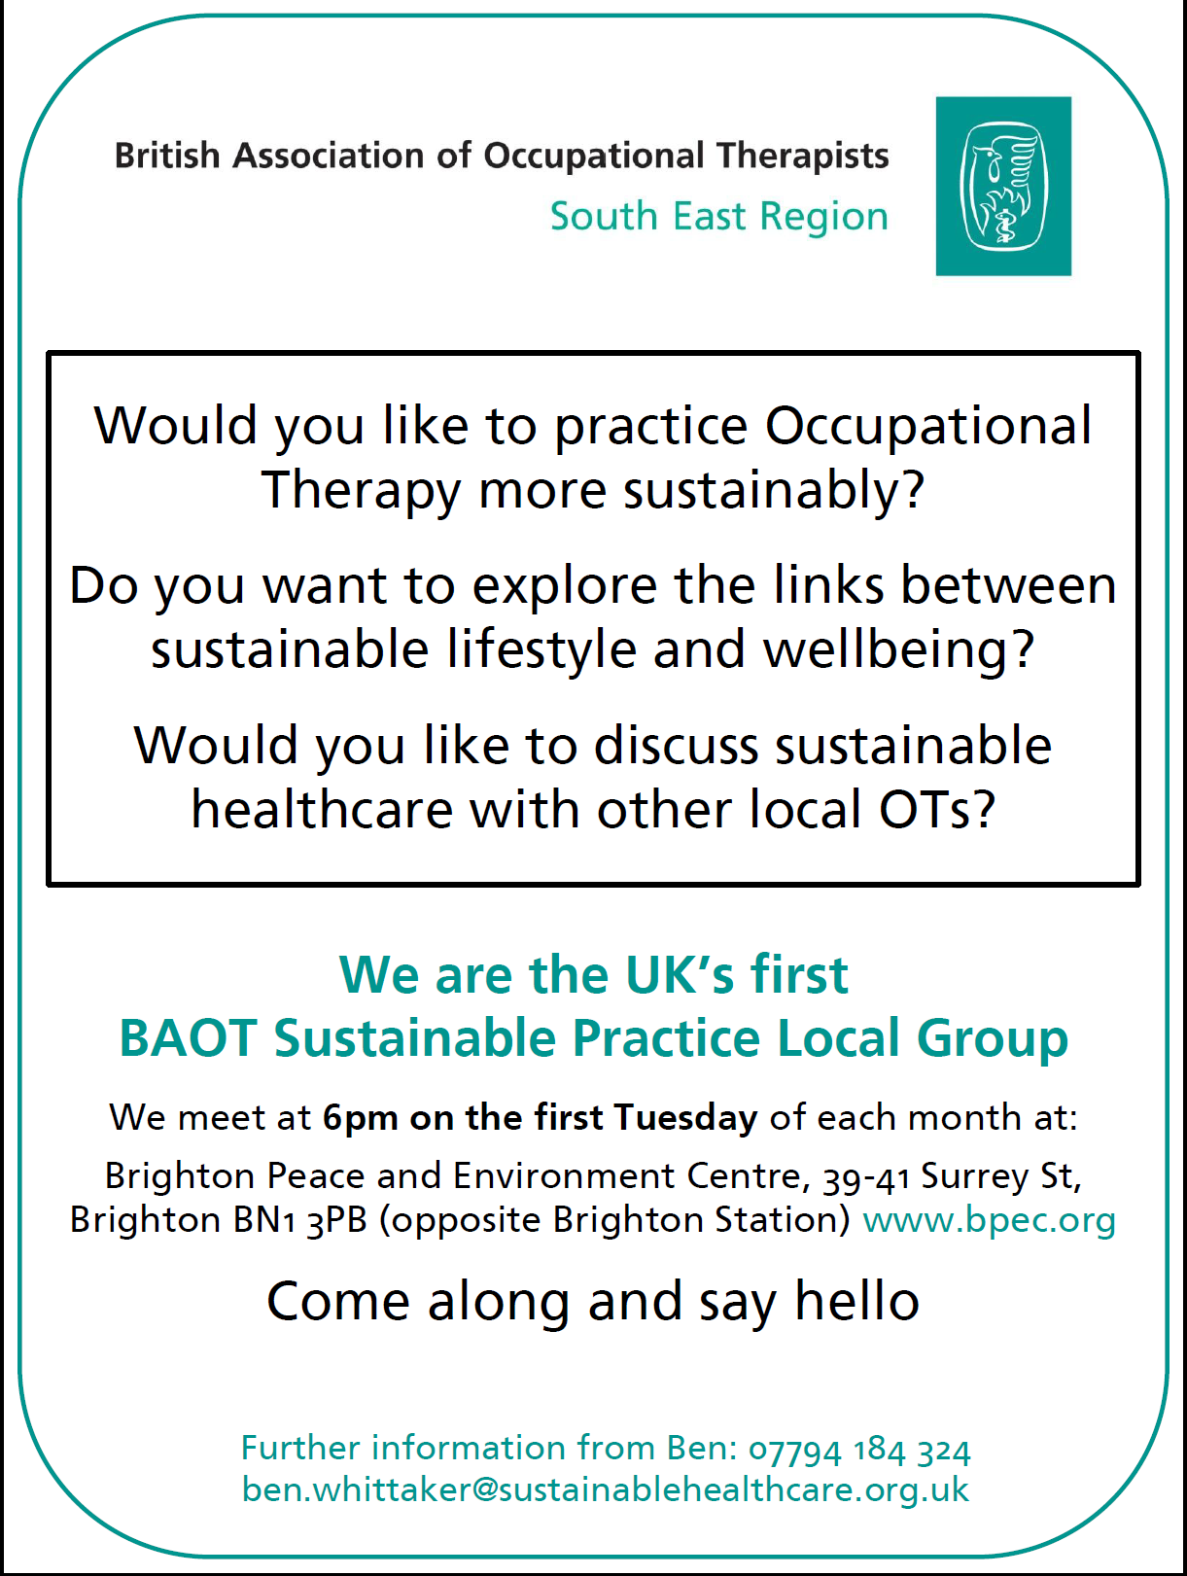

Slide 51
“Increasing concerns for the environment (and, ultimately, physical limits to resources) have the potential to counter trends towards materialism, individualism and consumerism, and in so doing could also contribute to our health and wellbeing, as individuals and as social beings in a finite but infinitely precious world.”
(Carlisle, Henderson and Hanlon 2009)

Slide 52
REFERENCES
10:10/Centre for Sustainable Healthcare (2010) 10:10 Occupational Therapy Checklist. Available at: www.sustainablehealthcare.org.uk/sites/default/files/1010_ot_checklist_1.pdf Accessed on: 29.06.2015
Barton H and Grant M (2006) A health map for the local human habitat. Journal of the Royal Society for the Promotion of Health, 126(6), 252-253
Carlisle S, Henderson G and Hanlon PW (2009) 'Wellbeing': a collateral casualty of modernity? Social Science and Medicine, 69(10), 1556-1560.
College of Occupational Therapists (2015) Code of Ethics and Professional Conduct. London: COT
Dieterle C (2013) Creating a Sustainable Lifestyle. Available at: www.sustainablehealthcare.org.uk/occupational-therapy-sustainable-practice-network-ot-susnet/blog/2013/02/creating-sustainable-lifest Accessed on: 04.03.2013
Hagedorn R (2004) Foundations for Practice in Occupational Therapy (Third Edition). Edinburgh: Churchill Livingstone
Mortimer F (2010) The sustainable physician. Clinical Medicine, 10(2), 110-111

Slide 53
REFERENCES
Mortimer F (2013) Transforming Models of Care: Sustainable Clinical Practice. CleanMed Europe, Oxford, 18.09.2013. Available at: http://cleanmedeurope.org/speakers/plenary-speakers-slides Accessed on: 12.03.2014
Montgomery H (2009) The Time for Action is Now. Available at: www.climateandhealth.org/getinformed/ Accessed on: 11.12.2010
Polatajko HJ, Townsend EA & Craik J (2007) Canadian Model of Occupational Performance and Engagement (CMOP-E). In: Townsend EA & Polatajko HJ (2007) Enabling Occupation II: Advancing an Occupational Therapy Vision for Health, Well-being & Justice through Occupation. Ottawa, ON: CAOT ACE
Sustainable Development Unit (2014a) Sustainable, Resilient, Healthy People & Places: A Sustainable Development Strategy for the NHS, Public Health and Social Care System. Cambridge: SDU. Available at: http://www.sduhealth.org.uk/policy-strategy/engagement-resources.aspx Accessed on: 09.02.2015
Sustainable Development Unit (2014b) Sustainable, Resilient, Healthy People & Places. Module: Healthy, Sustainable and Resilient Communities. Cambridge: SDU.
Sustainable Development Unit (2014c) Sustainable, Resilient, Healthy People & Places. Module: Sustainable Clinical and Care Models. Cambridge: SDU.

Slide 54
REFERENCES
Sustainable Development Unit (2015) Sustainable, Resilient, Healthy People & Places. Module: Creating Social Value. Cambridge: SDU
UCL Lancet Commission (2009) Managing the health effects of climate change. The Lancet, 373(9676), 1693-1733
UK National Ecosystem Assessment (2011) The UK National Ecosystem Assessment: Synthesis of the Key Findings. UNEP-WCMC, Cambridge
Watts (2009) The Health Benefits of Tackling Climate Change: An Executive Summary for The Lancet Series. Available at: http://download.thelancet.com/flatcontentassets/series/health-and-climate-change.pdf Accessed on: 01.12.2009
Whittaker B (2012) Sustainable global wellbeing: a proposed expansion of the occupational therapy paradigm. British Journal of Occupational Therapy, 75(9), 436-439
World Federation of Occupational Therapists (2012) Position statement: Environmental sustainability, sustainable practice within occupational therapy. Forrestfield, AU: WFOT
WCED (1987) Our Common Future: Brundtland Report. Oxford: Oxford University Press

Slide 55
websites
www.carbonaddict.org
www.climateandhealth.org
www.climateandhealthalliance.org
www.theclimateconnection.org
www.nhsforest.org
www.sustainablehealthcare.org.uk/ot-susnet
www.sap.sustainablehealthcare.org.uk
www.sd-commission.org.uk
www.sduhealth.org.uk
www.sustainabilityforhealth.org

Slide 56
ben.whittaker@sustainablehealthcare.org.uk

