Slide 1




Medicine Waste in Care Homes: Reducing Social and Environmental Impact
Notes:
Q exchange project, funded by Health Foundation and NHSE

Slide 2

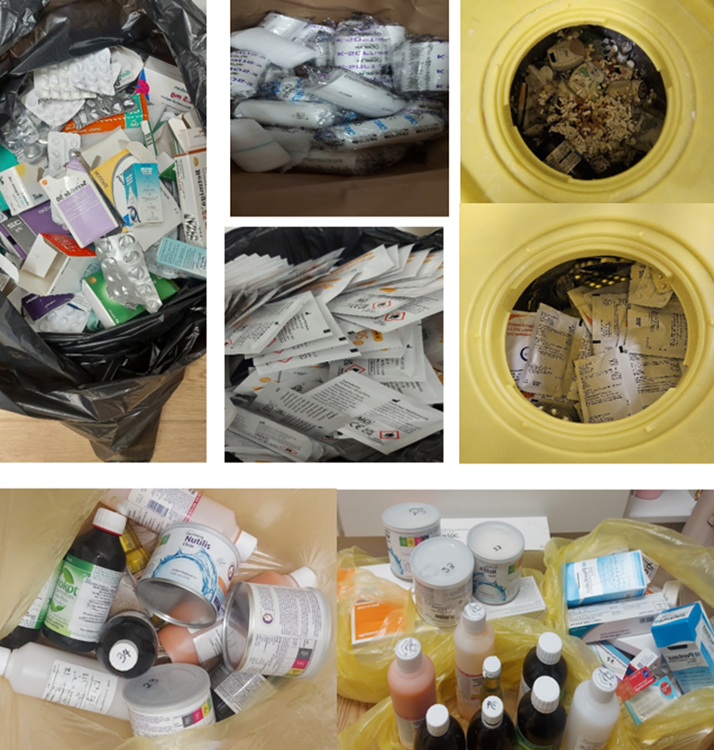




Segregation of medicines waste in care homes
Aim: To reduce the amount of packaging being unnecessarily disposed of in medicines waste bins.
Review current policy in line with guidelines.
Outcome: Updated medicines disposal process to ensure removal of packaging where appropriate. Clarification of process for bulky emollient tubs.
Environmental
Reduced volume of medicines waste going to incineration.
Reduced medicines disposal costs
Financial
  Staff feel more confident in how to dispose of medicines waste appropriately.
  Negative impact of increased staff time to remove medicines from packaging.
Social
Notes:
TEAM A

