Slide 1
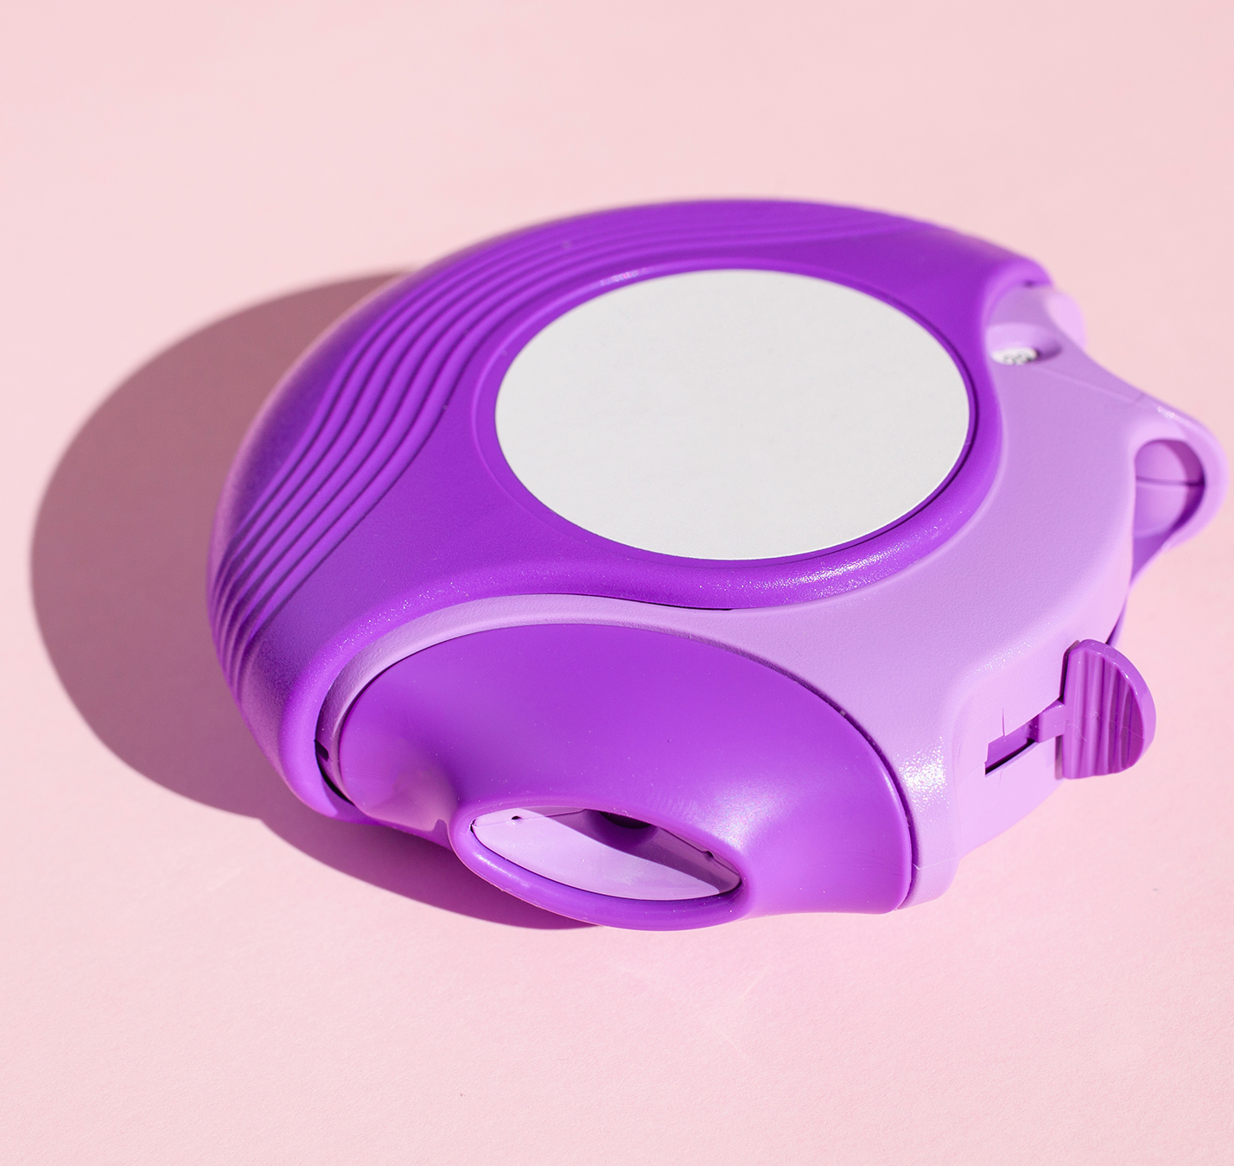
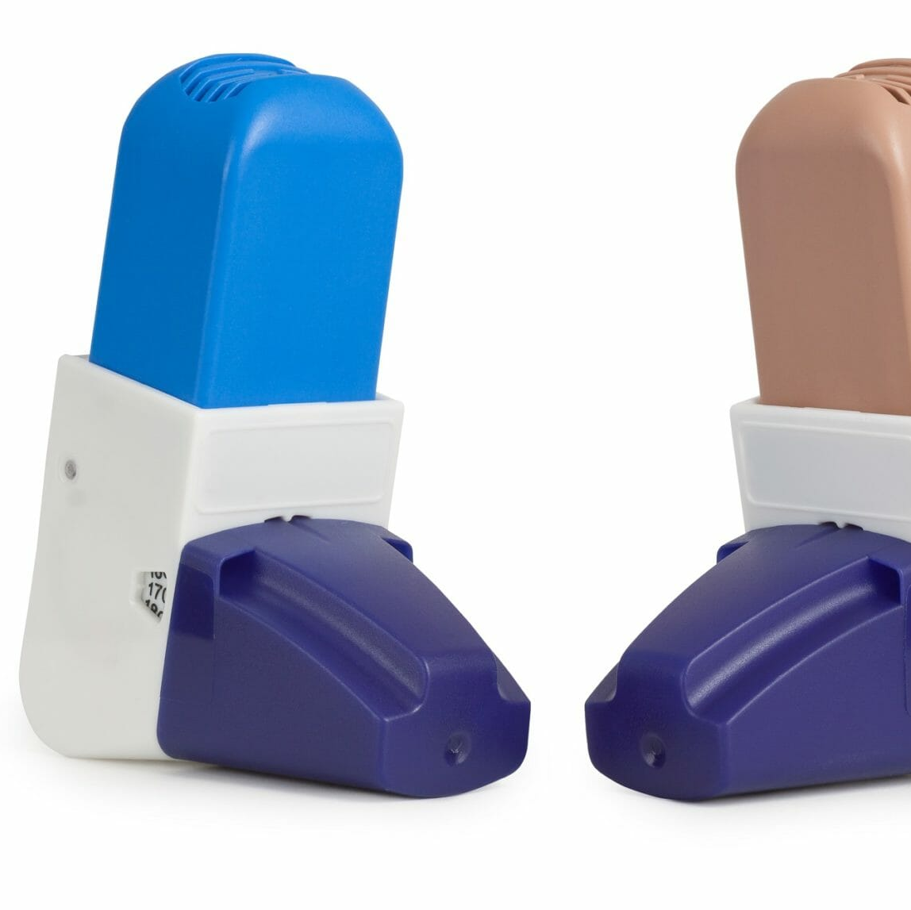
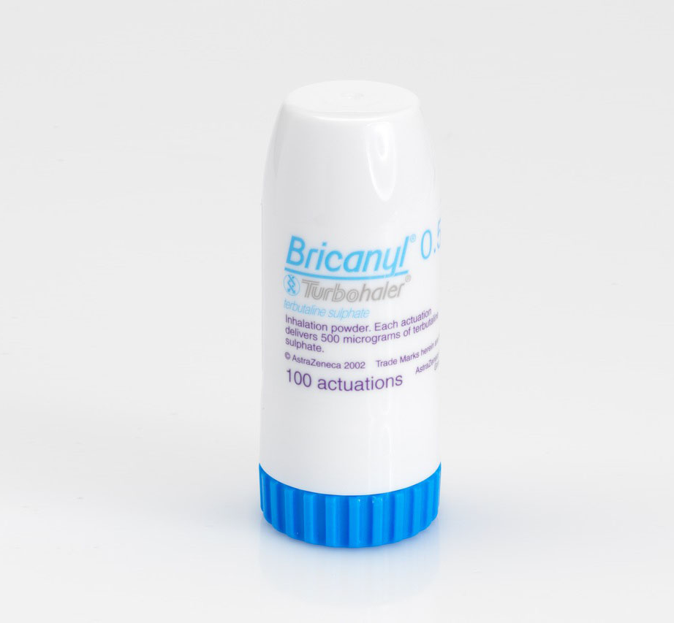
Sustainable inhaler prescribing for asthma

Slide 2
Why is inhaler prescribing a problem?
Inhaler emissions account for approximately 3% of the NHS carbon footprint, with metered dose inhaler (pMDI) propellants being responsible for the majority of this.
The NHS long-term aim is progress towards 50% reduction in inhaler emissions by 2028, from a 2019/2020 baseline.
Approx 92% of inhalers are prescribed in primary care
There is no evidence that using dry powder inhalers worsens control of asthma in any population. In fact, it might improve asthma control if patients find the new inhalers easier to use.

Slide 3
What can be done to reduce emissions?
NHS guidance - ‘to include dry powder inhalers over metered dose inhalers as the default option for adults and children over 12 years old, when clinically appropriate’
inhaler-carbon-footprint-comparison-tool-21.pdf
Reducing-Carbon-Footprint-of-Inhaler-Prescribing-v3.3.2.pdf
Each 200 dose of Ventolin evohaler MDI – 28 kg CO2e
= 115 mile car journey
Each 120 dose of flutiform or Symbicort MDIs – 35 kg CO2e
= 80 mile car journey
Each 200 dose airomir or salamol – 10kg CO2e
= 33 mile car journey
Each typical dry powder/soft mist inhaler - <1kg CO2e
= 1-2 mile car journey

Slide 4
Benefits of dry powder inhalers over MDIs:
It is breath actuated
A spacer is not needed
Do not need to hold breath after each use
Very portable
No propellant
Disadvantages:
Require adequate inspiration
May irritate throat
Humidity may cause clumping of powder

Slide 5

Search criteria
Patients with 'asthma’ coded as a problem since Mar 2021
Patients over 12 yrs old
Patients prescribed SABA inhaler/s currently or historically

Slide 6
The results - reliever inhalers

Slide 7
Combined inhalers (ICS+LABA)

Slide 8
Steroid inhalers

Slide 9
Cost?
Some patients are being switched from luforbec to fostair NEXT-haler which is roughly £15 more per inhaler.
Hardly any patients are being prescribed DPI salamol/salbutamol instead of the MDI version which is only 70p more per inhaler.
45 pt on salomol CFC free switched to salomol easyhaler = £31.50 extra cost
5 pt on luforbec switched to fostair NEXThaler= ~£75 extra cost
Fostair MDI and DPI inhalers cost the same, so why aren't pts being switched to DPI?
Beclometasone easyhalers are cheaper than Clenil modulite (£8.36 vs £9.05)

Slide 10
Conclusion
Generally, DPIs are under-prescribed, especially in the case of SABA inhalers.
Many patients have been switched to a DPI ICS/LABA inhaler already
More patients with asthma should be prescribed a combined DPI to reduce emissions and improve asthma control
These changes will not incur much additional cost

