Slide 1

pallcaresusnet@gmail.com

Slide 2

Achieving
Active
Aware
Notes:
Pilot sites

Slide 3
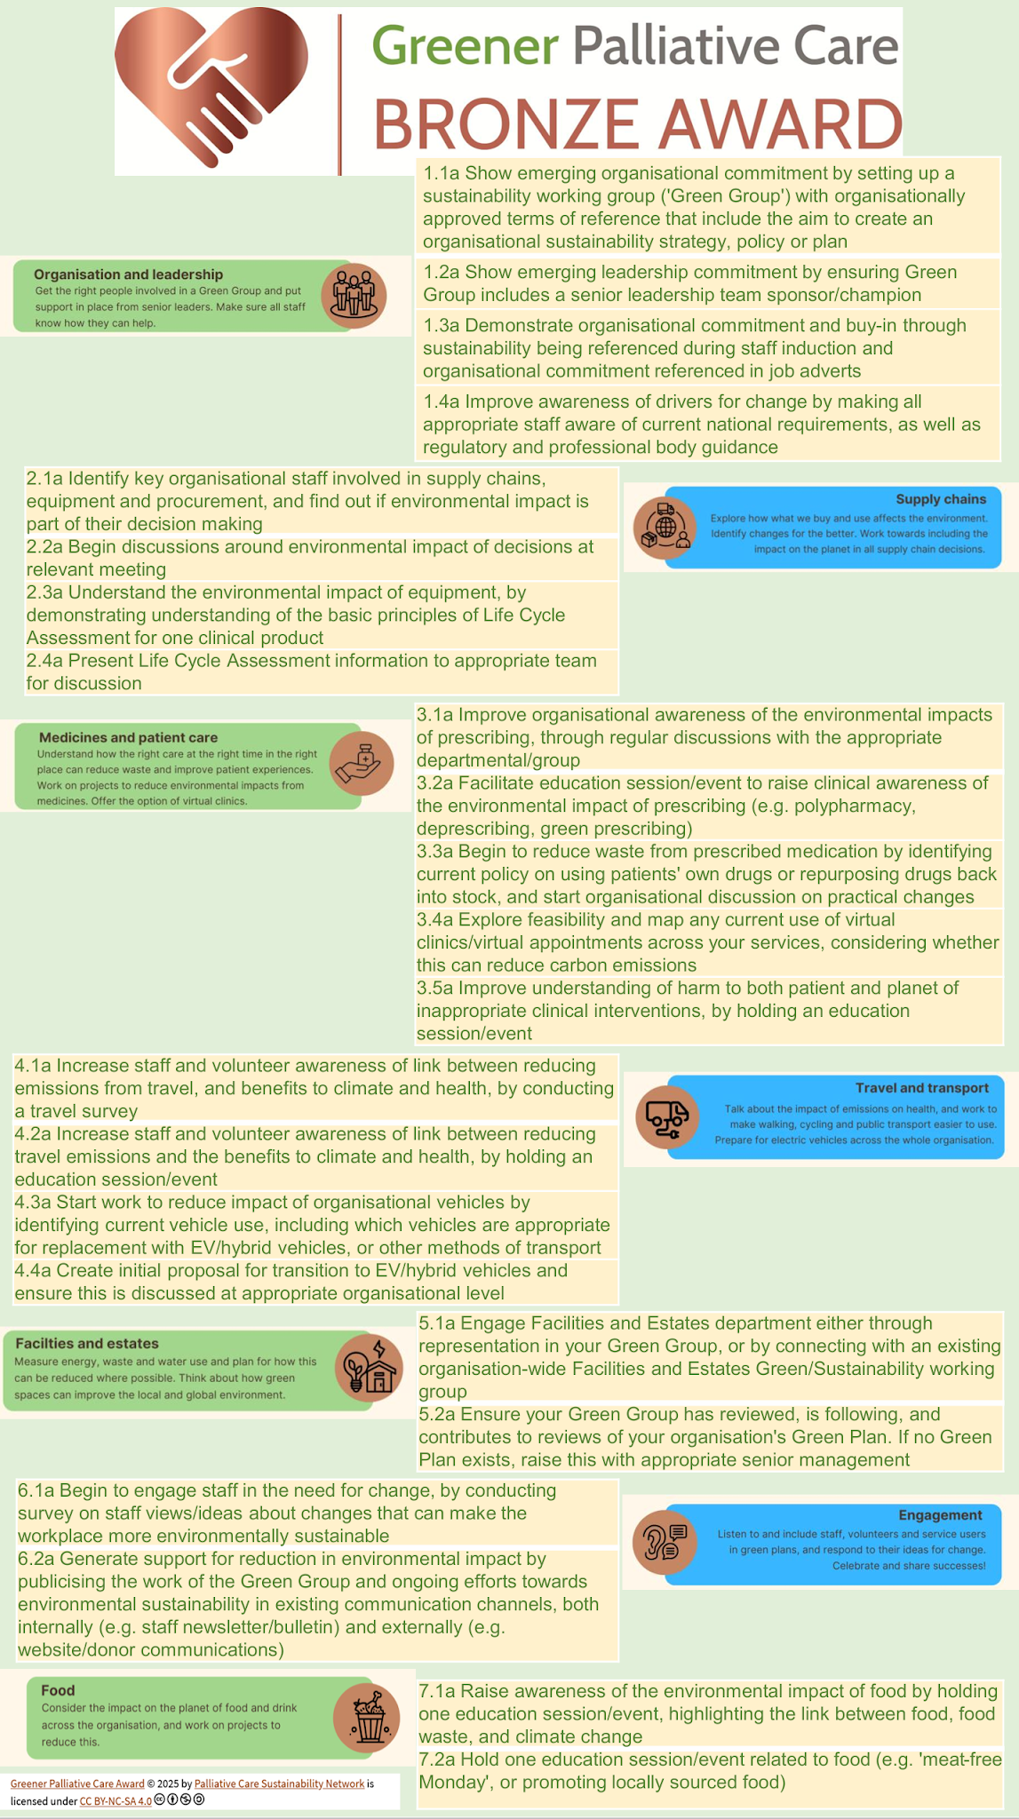
Full bronze criteria
Available at:
https://apmonline.org/greener-palliative-care-award/

Slide 4
How to apply to be assessed for Award……

Slide 5
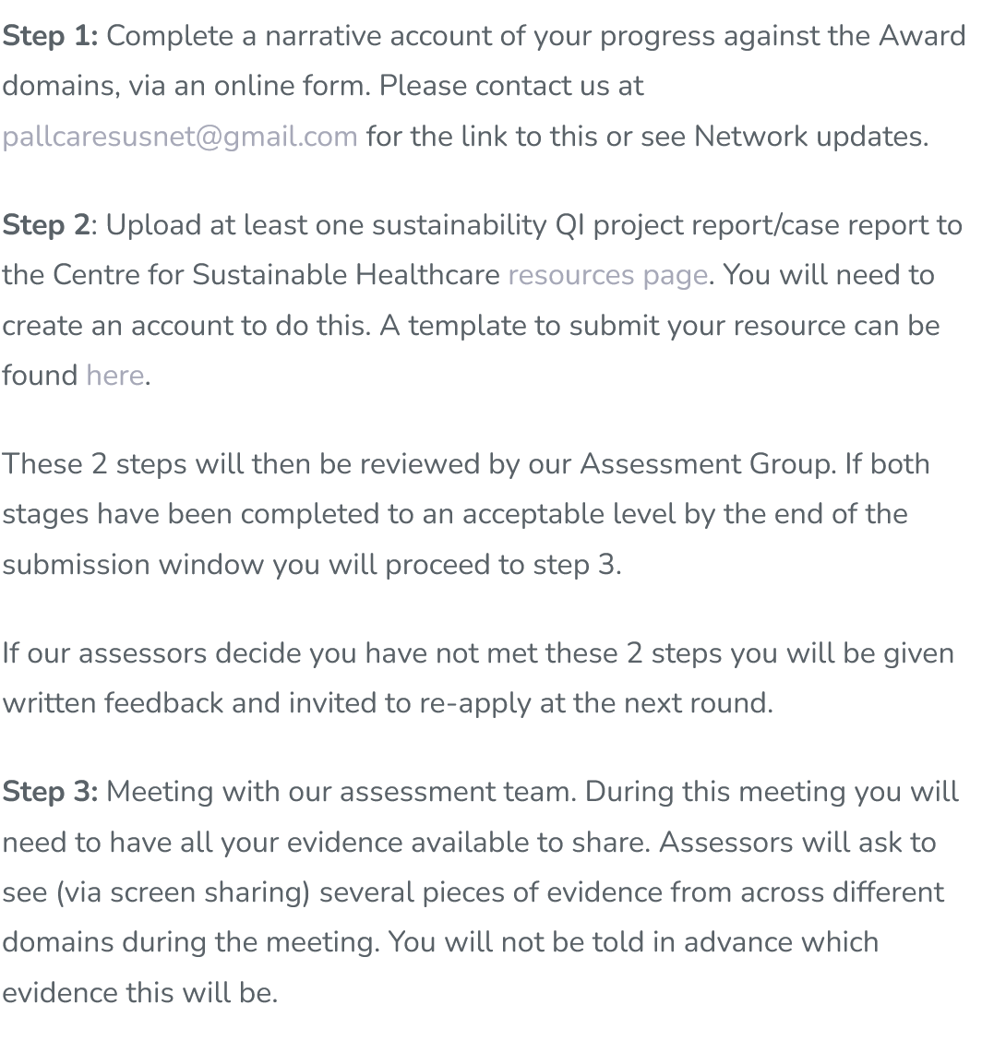
3 stages
Online form
Upload report/project
Online assessment meeting

Slide 6
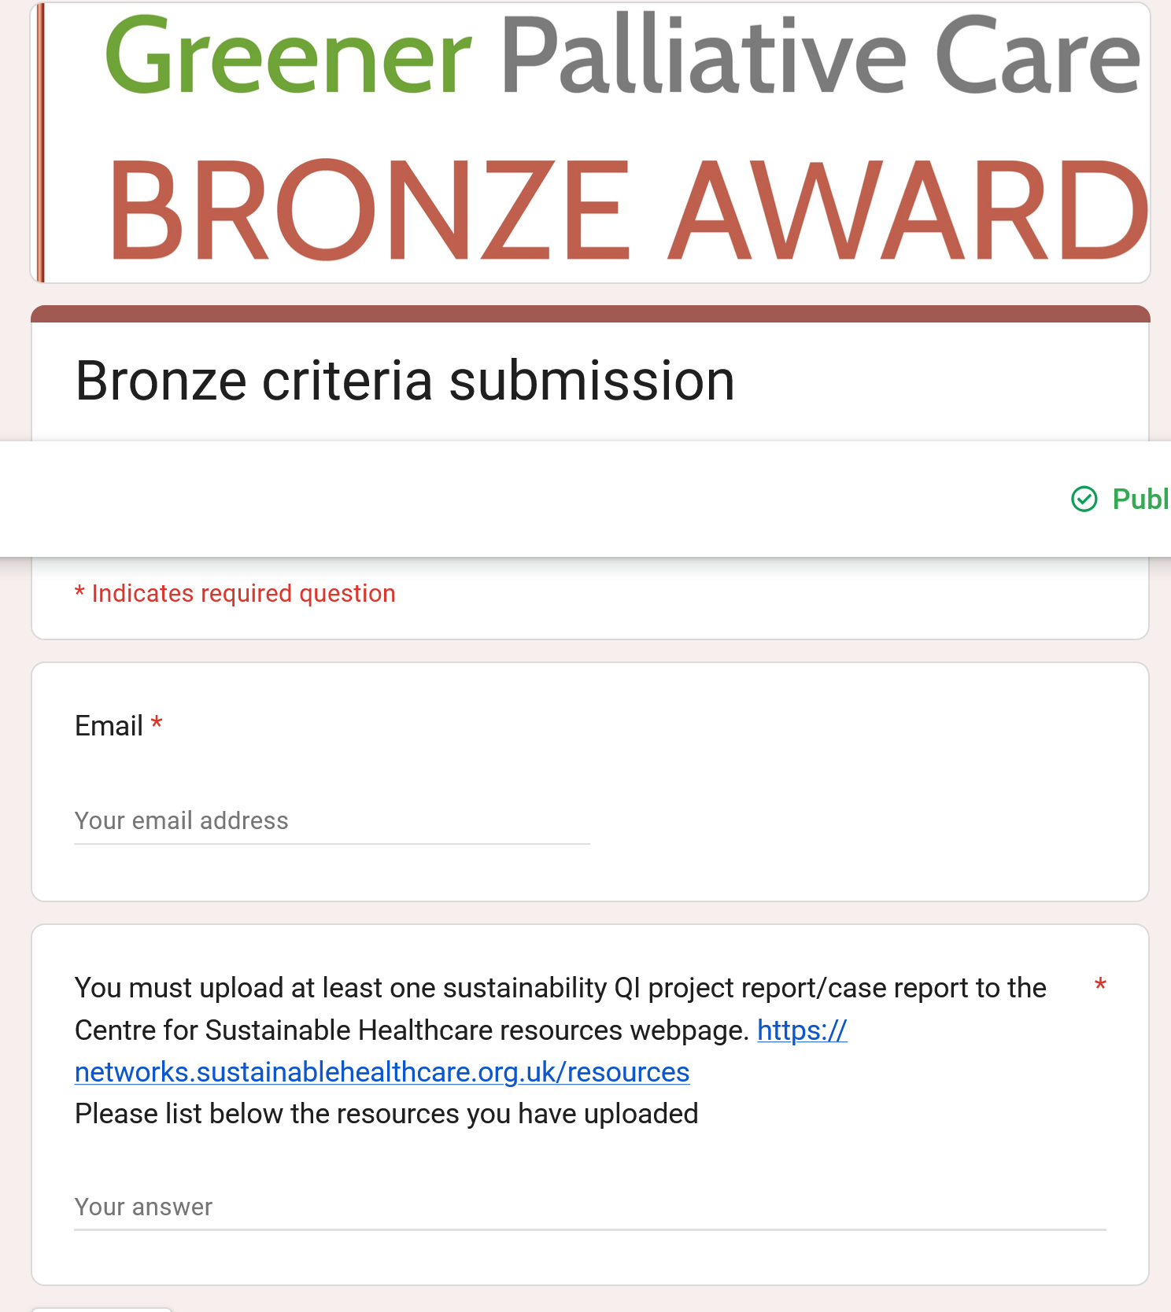

Slide 7
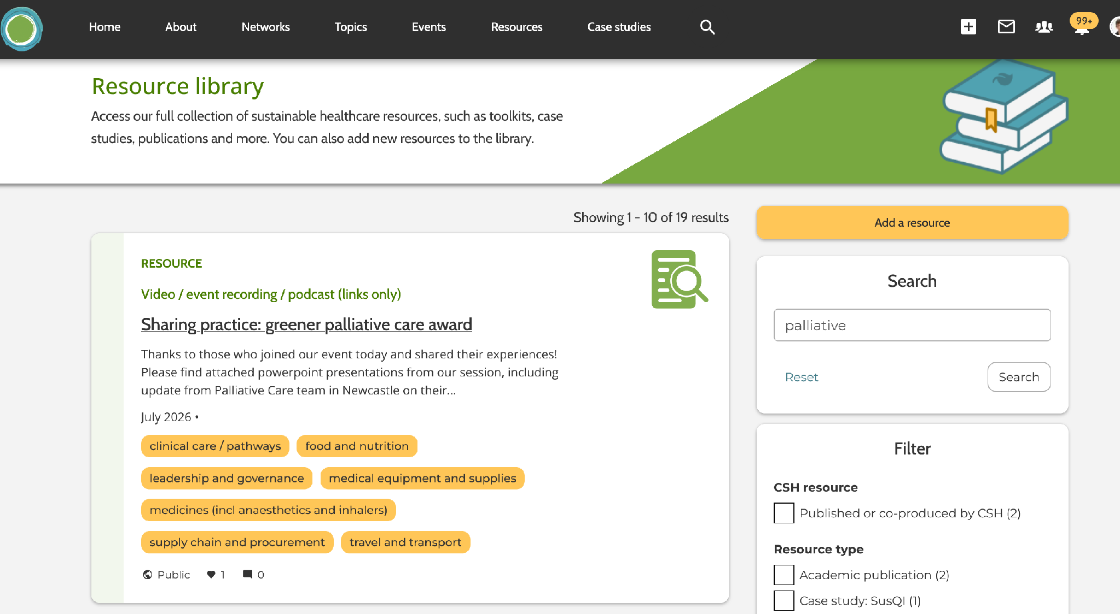
Case study/report
Form available here: https://docs.google.com/document/d/1ACSaRudMqF_Gw43PGHNDf9PTD4rZyy6L/edit
[APM/about/sustainability/Greener Palliative Care Award]
And needs to be uploaded here:
https://networks.sustainablehealthcare.org.uk/resources

Slide 8
Standards

Slide 9
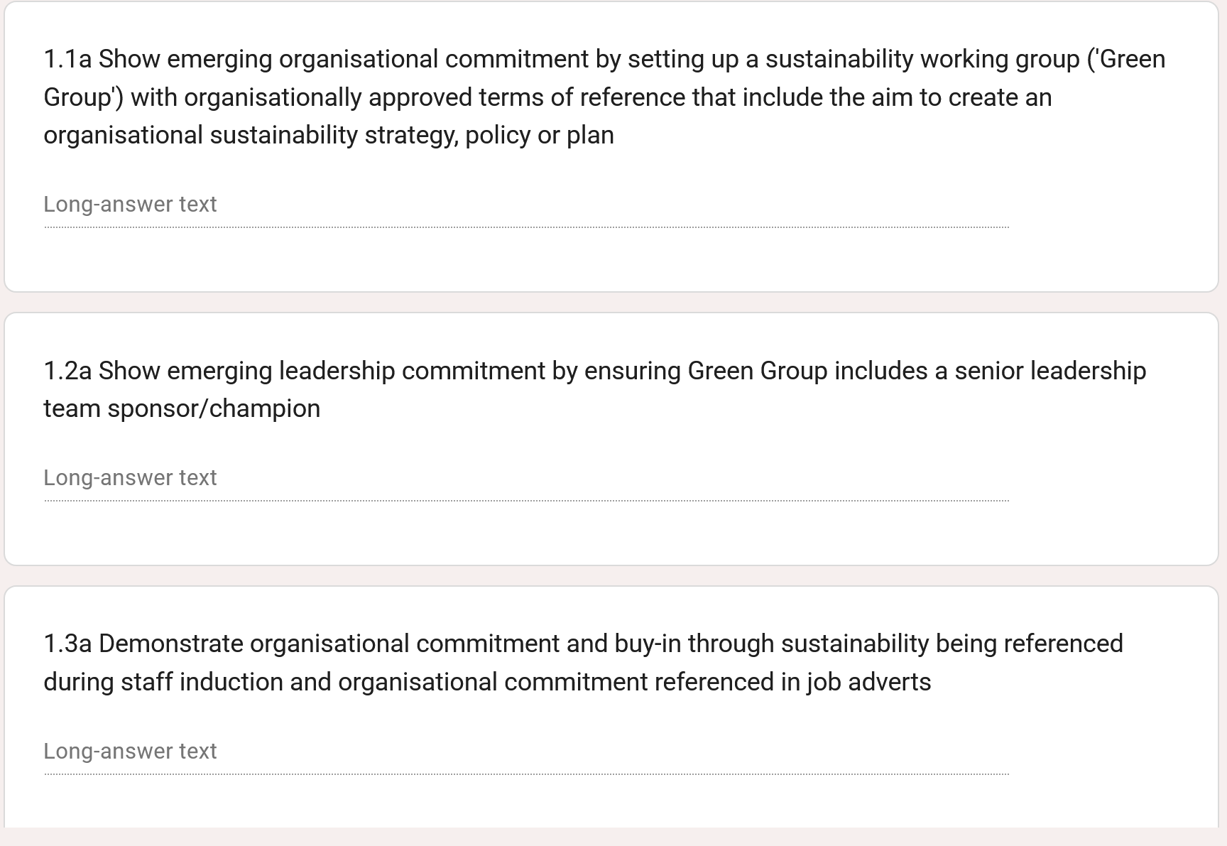
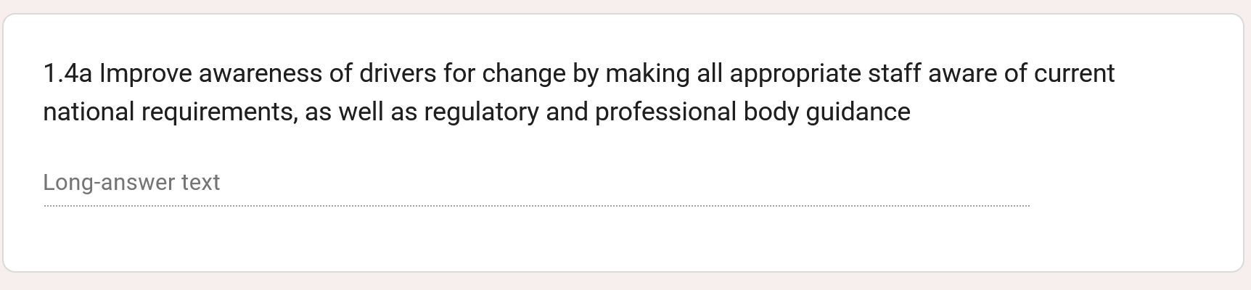

Slide 10
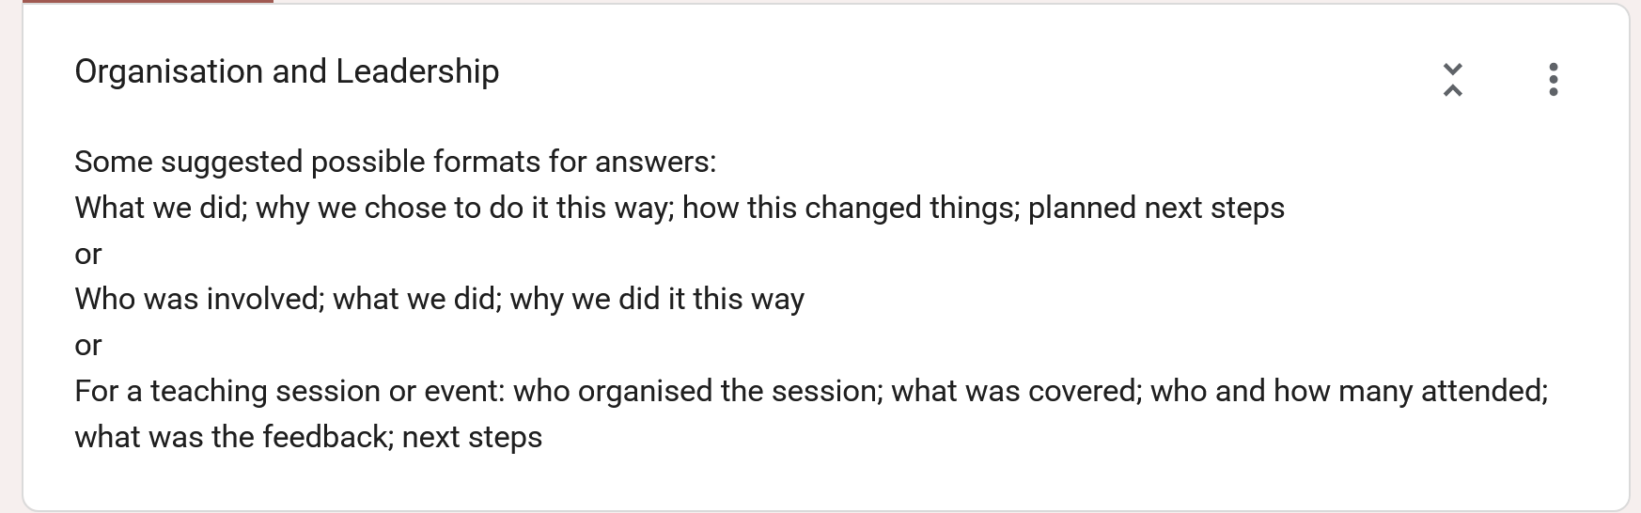
Suggested formats for answers

Slide 11
Standards
Narrative is fine!
You don’t have to upload evidence
You can include links – but you don’t have to at this stage
Evidence will be assessed at meeting

Slide 12
Practical need to knows
Can go forwards and backwards
Can’t save and come back to
AI use

Slide 13
Practical need to knows
Can go forwards and backwards
Can’t save and come back to
AI use
Link for form will be shared via network and email on 9th November (for this round)
*all key dates at end*

Slide 14
Some suggested possible formats for answers:
What we did; why we chose to do it this way; how this changed things; planned next steps
or
Who was involved; what we did; why we did it this way
or
For a teaching session or event: who organised the session; what was covered; who and how many attended; what was the feedback; next steps
or
How did we find the key people; what was the content of discussions; what do we plan to do next
or
How did we share what we have done; what worked well about this; what might we do better next time

Slide 15
Examples
The following are short versions to give you an idea
More detail is great- you can use names but please give us roles
If there is evidence you’re proud of and you’d love us to see, please mention this
Bullet points are OK!

Slide 16
1.3a Demonstrate organisational commitment and buy-in through sustainability being referenced during staff induction and organisational commitment referenced in job adverts
What we did; why we chose to do it this way; how this changed things; planned next steps
“Three member of the Green team met with HR to talk though what currently happens in staff induction and job adverts. We explained the Award and also why we feel it aligns with organisational values to make these changes.
We felt approaching HR directly was the most appropriate step so that we could understand any current issues/barriers. We could have chosen to go via SMT we decided to work out a plan first so that we could present this.
HR were supportive but felt they needed SMT approval to change induction. We then took this to the appropriate meeting and a change to include sustainability during health and safety induction was approved.
Job advert wording was suggested by us to HR; this went through the appropriate approval process.
We feel these changes shows up-front that as an organisation sustainability is important to us, and makes it clear it’s part of staff role. We plan to survey those who have done the new induction to ask their views.”

Slide 17
2.2a Begin discussions around environmental impact of decisions at relevant meeting [supply]
How did we find the key people; what was the content of discussions; what do we plan to do next
“Key people: more than we thought! We needed to talk to all the people involved in ordering equipment. This was clinical staff; admin staff; retail; facilities. We made a list during Green Group and invited staff to a meeting.
Content of discussions: what’s currently happening (good and bad); what policy exists; what we would all like to achieve
What we plan to do next: we have formed a working group to draft a sustainable procurement policy”

Slide 18
3.3a Begin to reduce waste from prescribed medication by identifying current policy on using patients' own drugs or repurposing drugs back into stock, and start organisational discussion on practical changes
Who was involved; what we did; why we did it this way
“We have submitted a case study report related to this work to the CSH website. Briefly, we met with our pharmacist to discuss what happens at the moment. They were in agreement that we could review the current policy on using patients’ own drugs. We obtained sample policies from other organisations and have used this to draft a new policy. This is being discussed at clinical governance. The meetings with pharmacy also highlighted a number of other areas were we could improve on medicines use and waste which the Green Group is looking at.”

Slide 19
4.4a Create initial proposal for transition to EV/hybrid vehicles and ensure this is discussed at appropriate organisational level
Email sent to senior admin staff to request details of all company vehicles
Teams call held to talk about which vehicles we have and which are already EV/hybrid. We also discussed the current barriers to change.
Identified closest EV charging points to hospice currently through using EV app
Survey sent to organisational staff to ask of those who drive who uses EV or hybrid and for their experiences
One page report created for SMT with numbers of current hospice vehicles (including retail) and types; key comments and experiences from staff
Presented current carbon emissions for these using data from mileage and presented how this would change with EV use
Attended meeting to hear how SMT will consider change

Slide 20
5.2a Ensure your Green Group has reviewed, is following, and contributes to reviews of your organisation's Green Plan. If no Green Plan exists, raise this with appropriate senior management
What we did; why we chose to do it this way; how this changed things; planned next steps
“What we did:
Our NHS Trust has a published green plan for 2025-2030. We decided to review this together during our palliative care Green Group meeting. We decided to split the report up and each member fed back on a specific area and how this could relate to our team. We then had a discussion (recorded in the meeting minutes) about areas we could contribute to and where we felt there might be gaps.
Why we chose to do it this way:
The report is very long, and we knew it would be unrealistic to all read it. This way we could each develop an interest in one area.
How this changed things:
This has really helped us to keep connected to the Trust’s work and we plan to review the Green Plan in our Green Group regularly and to keep attending Trust meetings
Planned next steps:
We asked to attend the next Trust sustainability group to talk about the Greener Palliative Care Award and to highlight 3 key ways we could support the trust in it’s Green Plan.”

Slide 21
6.2a Generate support for reduction in environmental impact by publicising the work of the Green Group and ongoing efforts towards environmental sustainability in existing communication channels, both internally (e.g. staff newsletter/bulletin) and externally (e.g.website/donor communications)
How did we share what we have done; what worked well about this; what might we do better next time
“We shared the work of our Green Group and publicised our meat-free Monday event in our staff newsletter. We also added a section on sustainability to our website. The staff newsletter did generate some emails with people asking to join the group. Although this was initially a one off to keep the moment going we’re discussed with our comms team if we can have a regular slot. We’d like to share more externally but are working with our fundraising team on the best way to do this.”

Slide 22
7.1a Raise awareness of the environmental impact of food by holding one education session/event, highlighting the link between food, food waste, and climate change
who organised the session; what was covered; who and how many attended; what was the feedback; next steps
“Our Green Group decided to organise a stall in our canteen. We felt this was the best way to reach as many people as possible. We did this for three days. We covered how food production and food waste affects climate by having a poster and asking people to guess carbon emissions of various foods. We had about twenty people each day, from across the organisation. The feedback was really positive with lots of comments that people would welcome food waste recycling. We’ve reviewed the event at our Green Group and have suggested to the facilities teams we try to introduce food waste bins across the organisation. We have pictures from the event we’d love to share!”

Slide 23
Assessment meeting
If completed form and uploaded project to CSH
Invited to meeting
Around an hour, at least 2 of our assessment team
No presentation needed- but have your evidence to hand
We won’t tell you in advance what evidence we want to see
A chance for us to meet you and hear about your successes and challenges
Ensuring credibility/validity

Slide 24
Key dates for Winter 2026/7
Monday 9th November 9am- form live
  Monday 16th November 9am- form closes
Maximum 30 applications- first come first served

Slide 25
Key dates for Winter 2026/7
Monday 9th November 9am- form live
  Monday 16th November 9am- form closes
Maximum 30 applications- first come first served
(assessment group meets)
Early December- feedback from application
Meetings- 5-12th January 2027
Next round likely May/June but tbc

Slide 26
Being reviewed post pilot
Likely launch January 2027
Similar process for silver with more case studies
Gold will meet with our team first

Slide 27
New assessment team members wanted!
Chance to meet other interested organisations and people, and be inspired
Email pallcaresusnet@gmail.com
Questions?

